Slide 1
Welcome to Y1

Slide 2

Life in year 1
Ready to learn:
Reading diary
Phonics folder
Snack
Water bottle (into school on Monday, home on Friday)
Waterproof coat
Please ensure all items are named. Including shoes!!
Independence
The children are responsible for their ‘ready to learn’ items.
PE kits and Forest School

Slide 3
Reading in Y1

Slide 4
Reading in year 1
Daily ERIC time
Daily whole class story time – fiction/nonfiction
Individual reading with member of staff – aim for x1 a week
‘Dream Reads’ book to take home
Birthday books – Amazon wish list (we will be updating this!)
Book corner – children can use during ERIC time or Challenge Time
High quality text for each foundation subject
World Book Day
School library
Guided Comprehension (VIPERS) sessions twice per week (Summer term)
New reading reward scheme (more information to follow)

Slide 5

Reading books
‘Tree’ books
These books should be just below the children’s phonic ability and contain digraphs which the children have a secure understanding of. The children should be able to read these books with increasing fluency.
We check reading diaries every day and change them as soon as your child has finished their book.
Please forgive us if you get a book more than once. There’s a lot of children and a lot of books! It’s great to re-read a book for fluency.

Slide 6
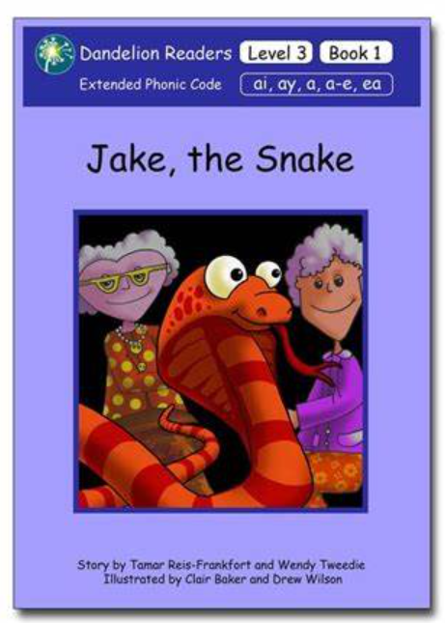

Reading books
Phonics teaching books
Phonetically decodable books which directly link to the phonics being taught in school that week.
These are sometimes repeated, depending on whether the class/individual children are struggling with specific digraphs.
These books are changed every Monday.
How to help at home if your child is finding them tricky:
You can read the book to your child and they can spot the focus sound.
You can read most of the sentences to them, but get them to read the words with the focus sound.
Do a page a day if that helps, you have all week!

Slide 7

Reading books
Dream Reads
The children have a range of high-quality fiction and non-fiction texts that can choose from, to read during ERIC time. These books also get to home, to share with you!
Your child is responsible for changing their Dream Read book when needed. They can do this first thing in the morning, during ERIC time.
Don’t worry – we will remind them to change their books!

Slide 8

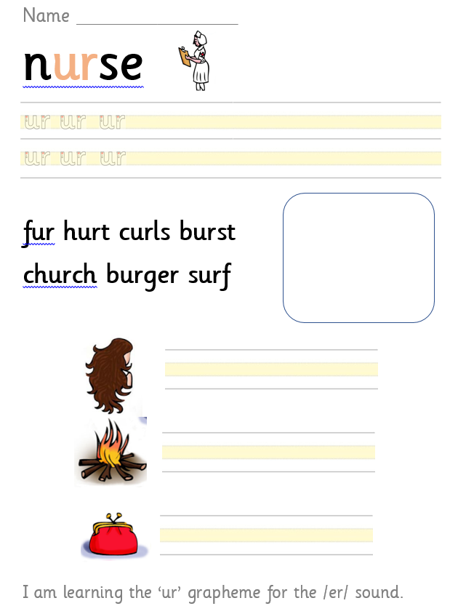
Phonics sheets
“ur as in nurse”
How you can use the sheets at home:
Discuss what they have learnt each day.
Re-read the words on the sheet
Use the back of the sheet to practise handwriting or writing words/sentences containing the focus grapheme.
Keep revisiting previous sheets too!
handwriting
decoding – reading
(sound buttons and robot arms)
encoding – writing

Slide 9
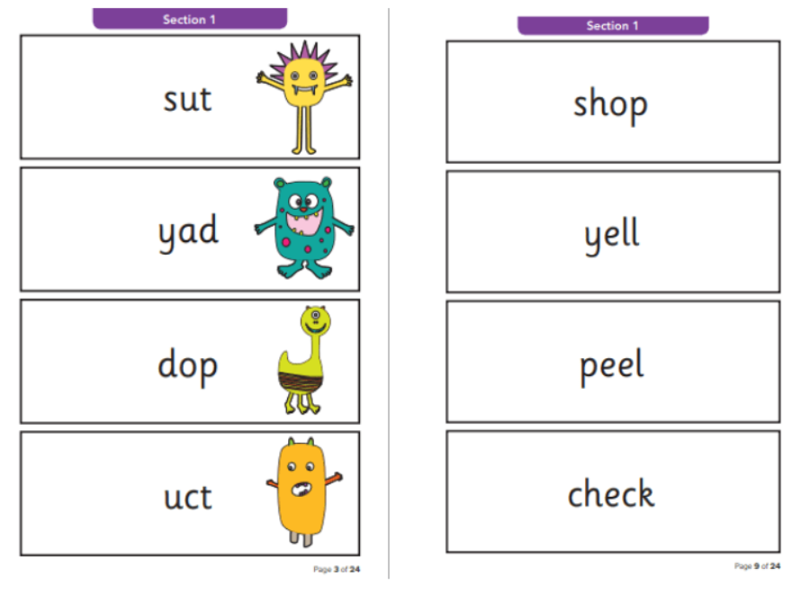
Phonics screening check
In June, all Year 1 children will undertake a phonics screening check, to assess the standard of their decoding and blending skills.
The test contains 40 real and ‘alien’ words for the children to read.
The results are used to analyse the school’s performance. The results won’t have any impact on your child so please do not worry!
If your child does not reach the pass mark (which is usually 32/40), then they can retake it in Year 2.

Slide 10


New reading reward scheme
Every 10 reads
special stamp in the reading diary
50 reads
bronze award
100 reads
silver award
150 reads
gold award

Slide 11
How you can help
Year 1 is a “bridge to fluency” so we are aiming for the children to move on from blending individual sounds into a word to being able to read a whole word and then sentences fluently.
To support this at home, we need to encourage children to re-read words and sentences back.
Read with your child EVERY day
Record all reading at home in their reading diary
Read to them and talk about the story
Read when you are out and about – menus, signs, recipes, road signs etc.
Revisit the phonics folders regularly at home
Use the phonics books in a way that works for your child and their reading ability

Slide 12
Any questions about reading?

Slide 13
maths in Y1

Slide 14

In year 1, our maths lessons…
Follow the Can Do Maths scheme
Are whole class
Use lots of practical resources
Have a large focus on addition and subtraction
Provide opportunities for children to practise ‘doing’ and deepen their understanding, depending on their own ability

Slide 15
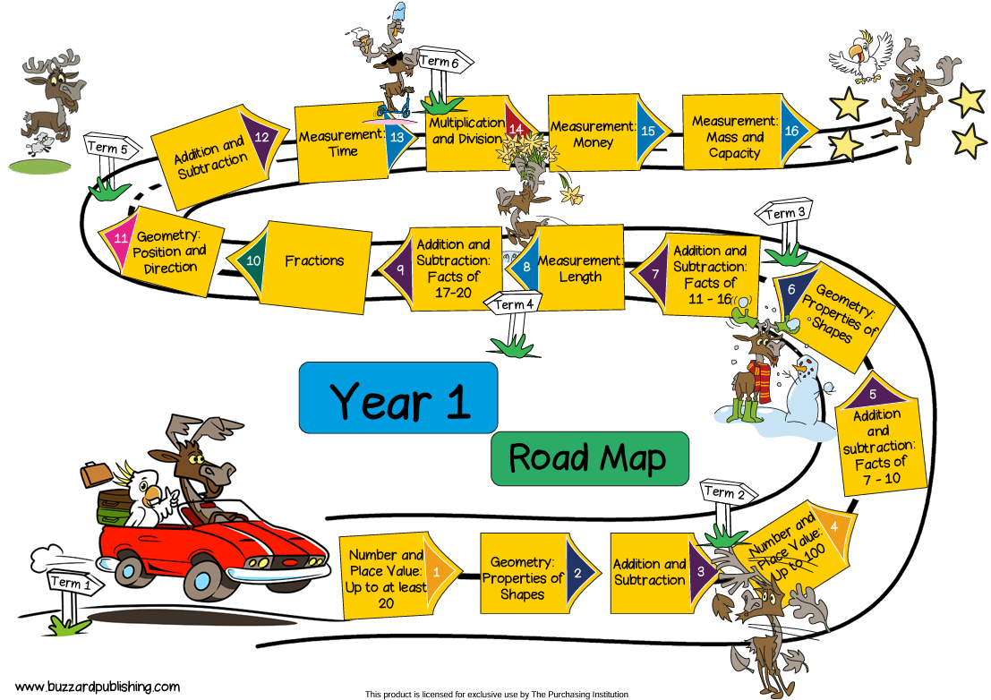

Slide 16
Lesson structure
Whole class on the carpet – revisiting prior learning, introducing new vocabulary and teaching the lesson focus, demonstrating strategies and using practical resources
Children practise new learning using practical resources
Children work at tables to work through a do it challenge, secure it challenge and deepen it challenge – recording in their maths books

Slide 17
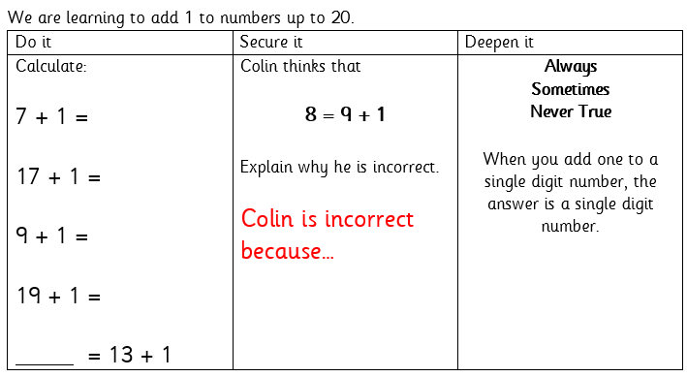
do it, secure it, deepen it
Do it:
Simple calculations based on the learning objectives.
We work practically, using resources.
Doing it!
Deepen it:
Using what you’ve learnt to solve problems.
Using maths thinking to explain, prove and explore learning in different ways.
Secure it:
Developing reasoning skills. Colin is always incorrect, but the children need to explain how they know.

Slide 18

How you can help
The best thing you can do is ensure your child is secure in number recognition to 100 and addition and subtraction within 20. There are some really easy ways you can do this!
Walking home – “what number is on that door?”
“I have 5 peas on my plate, you have 4 peas on your plate, how many peas do we have altogether?”
“We have 4 ice lollies in the freezer, but we’re going to take 2 out for us to eat. Let’s count how many are left.”

Slide 19
Any questions about maths?

