Slide 1
WELCOME TO Y2

Slide 2
year 2
Super start all round!
Y2 is a continuation from Y1 – many similarities!
Building independence and resilience - changing books, coats, PE kits, relaying messages etc.
Jobs and responsibilities
Clubs – details this week
Reading buddies
Rotation morning - Wednesday
Challenge Time

Slide 3
Reading in Y2

Slide 4

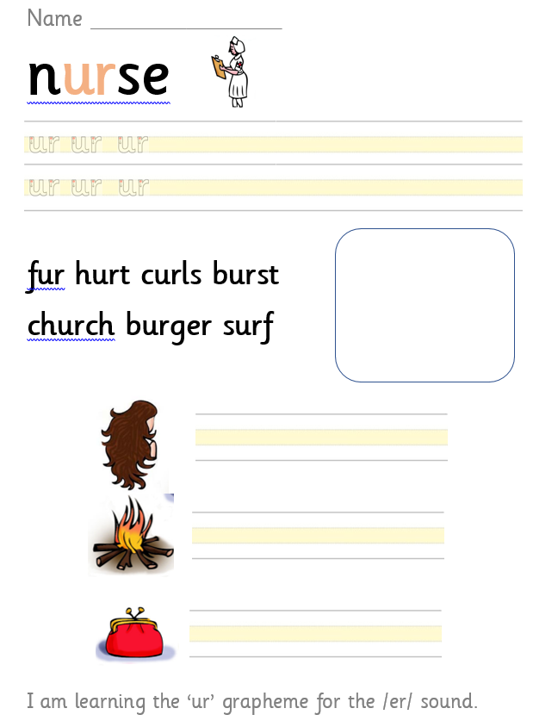
Phonics in Y2
“ur as in nurse”
Continuation from Y1
X4 Phonics lessons a week
Revising alternative graphemes /ai/ /ee/ /ie/ /oa/ /ue/
Revise any gaps in GPCs using our phonics tracking system
New unusual GPCs e.g /ai/ eigh /oa/ eau
Weekly links via seesaw to support weekly phonics learning
Move on to spelling/grammar sessions after Christmas

Slide 5
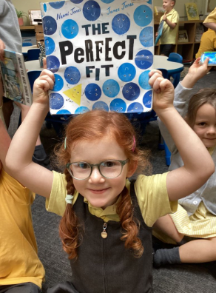
Reading in year 2
Daily ERIC time
Daily whole class story time – fiction/nonfiction
Individual reading with member of staff – aim for x1 a week
‘Dream Reads’ book to take home
Birthday books – Amazon wish list (we will be updating this!)
Book corner – children can use during ERIC time or Challenge Time
High quality text for each foundation subject
World Book Day
School library
Guided Comprehension (VIPERS) sessions twice per week (Summer term)
New reading reward scheme (more information to follow)

Slide 6

Reading books
‘Tree’ books
These books should be just below the children’s phonic ability and contain digraphs which the children have a secure understanding of. The children should be able to read these books with increasing fluency.
We check reading diaries every day and change them as soon as your child has finished their book.
Please forgive us if you get a book more than once. There’s a lot of children and a lot of books! It’s great to re-read a book for fluency.

Slide 7

Reading books
Dream Reads
The children have a range of high-quality fiction and non-fiction texts that can choose from, to read during ERIC time. These books also get to home, to share with you!
Your child is responsible for changing their Dream Read book when needed. They can do this first thing in the morning, during ERIC time.
Don’t worry – we will remind them to change their books!

Slide 8
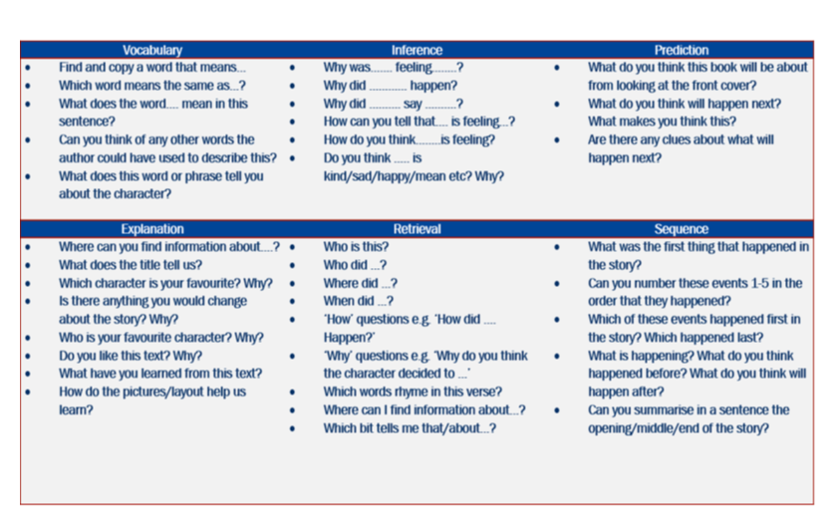

How do we support children's comprehension?
During individual reading sessions, class story time sessions and Guided Comprehension sessions we ask children questions like these. This will continue in Y3

Slide 9
How you can help
Year 2 is about building fluency and improving comprehension..
Read with your child EVERY day!
Record all reading at home in their reading diary
Read to them – share longer texts and discuss the story –prediction, sequencing etc. VIPERS
Listen to audio stories and discuss
Read when you are out and about – menus, signs, recipes, road signs etc.

Slide 10


New reading reward scheme
Every 10 reads
special stamp in the reading diary
50 reads
bronze award
100 reads
silver award
150 reads
gold award

Slide 11
Any questions about reading?

Slide 12
maths in Y2

Slide 13

In year 2, our maths lessons…
Continue to follow the Can Do Maths scheme
Are whole class
Use lots of practical resources
Have a large focus on addition and subtraction but introduce multiplication and division including 2x 5x 10x tables.
Provide opportunities for children to practice ‘doing’ and deepen their understanding, depending on their own ability

Slide 14
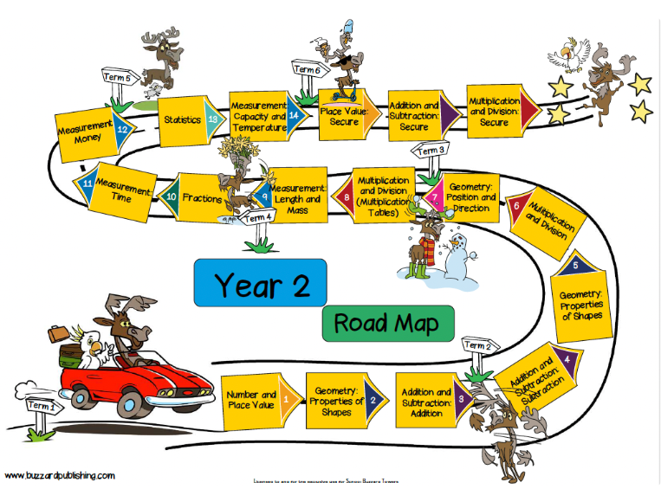

Slide 15
Lesson structure
Whole class on the carpet – revisiting prior learning, introducing new vocabulary and teaching the lesson focus, demonstrating strategies and using practical resources
Children practice new learning using practical resources
Children work at tables to work through a do it challenge, secure it challenge and deepen it challenge – recording in their maths books

Slide 16
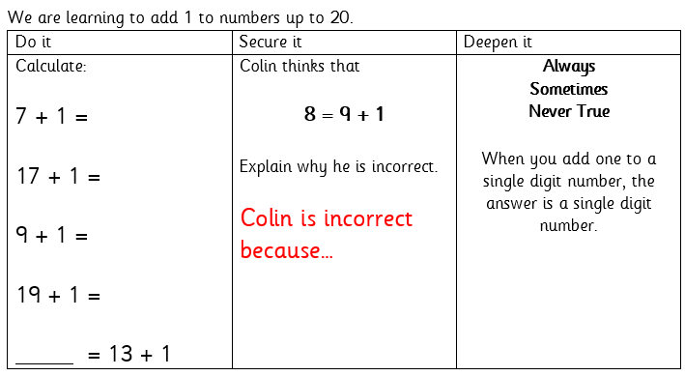
do it, secure it, deepen it
Do it:
Simple calculations based on the learning objectives.
We work practically, using resources.
Doing it!
Deepen it:
Using what you’ve learnt to solve problems.
Using maths thinking to explain, prove and explore learning in different ways.
Secure it:
Developing reasoning skills. Colin is always incorrect, but the children need to explain how they know.

Slide 17

How you can help
The best thing you can do is ensure your child is secure in number recognition to 100 and addition and subtraction within 20. There are some really easy ways you can do this!
Deliberate practice on Purple Mash
Numbots
1 minute maths
Card games using addition and subtractions skills
Practice all number bonds up to 20.
2x 5x 10x tables

Slide 18
Any questions about maths?

