Slide 1

English at Charlton Kings Infants’ School
Parent Workshops
September 2026

Slide 2
Aims of the Session:
To understand the expectations by the end of YR
To understand how English is taught in our school
To understand how to support your child’s learning at home

Slide 3
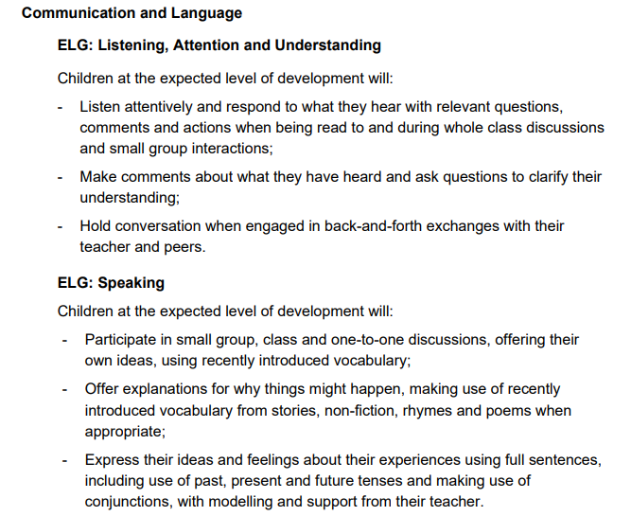
Early Learning Goals

Slide 4
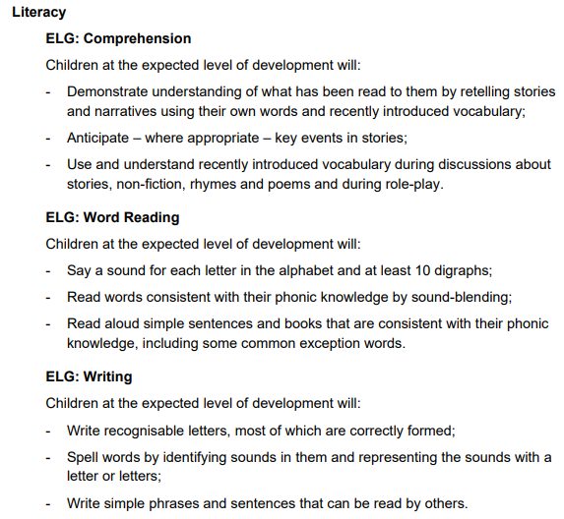
Early Learning Goals

Slide 5

Phonics International programme
www.phonicsinternational.com
Downloadable resources and video clips
Charlton Kings Infants School uses…

Slide 6
Synthetic Phonics Programme
  Sounding out and blending for reading
  Segmenting to spell-identifying sounds in words
  Letter formation

Slide 7
The Alphabetic Code
Letters and letter groups are code for the individual sounds in our speech.
Decoding the letter symbols into sounds is the basis for reading:
See the printed word soap, say the sounds
/s/ /oa/ /p/, blend the sounds to read “soap”

Slide 8
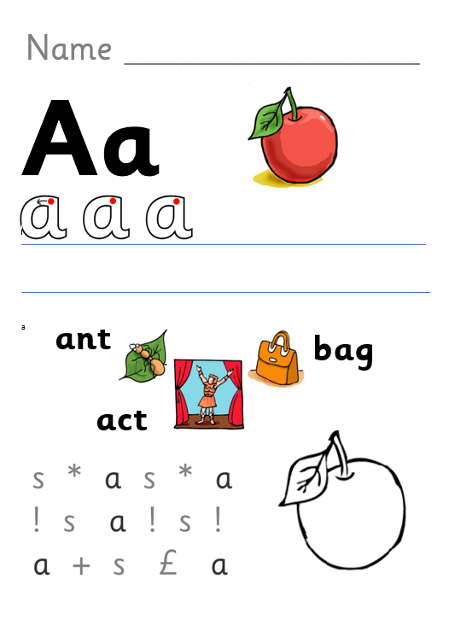
Phonics Sheets
Capital and lower case
Practise formation using a patter
Encourage correct pencil grip
Listen for the sound in words
Segment words using phonics fingers
Take home to revisit
Notes:
‘

Slide 9
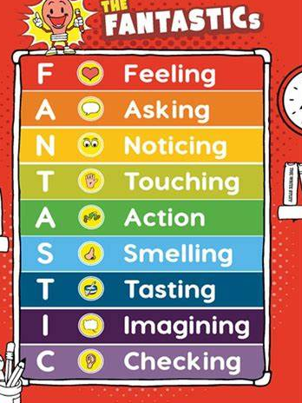
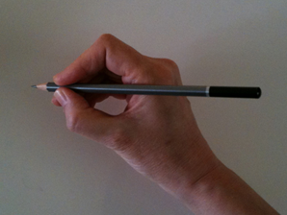

Writing
We use a scheme called The Write Stuff.
High emphasis placed on improving vocabulary using the ‘fantastics.’
Within challenge time there are lots of opportunities to develop gross motor and fine motor skills which are the foundations of developing handwriting skills.
Encourage correct pencil grip.
‘Snappy fingers and froggy legs’.

Slide 10


Reading Rewards
We are introducing a reading reward scheme!
Every time your child reads their reading book at home please record it into their reading diary.
A stamp will be given in reading diaries for every 10 ‘home reads’.
Bronze award – 50 reads
Silver award – 100 reads
Gold award – 150 reads

Slide 11
Home/School Links
Practise handwriting patterns at home.
Reading and phonics folder for sheets.
Phonically decodable books matching the sounds that we are teaching.
Home sharing books from our ‘Dream Reads Box’.

Slide 12
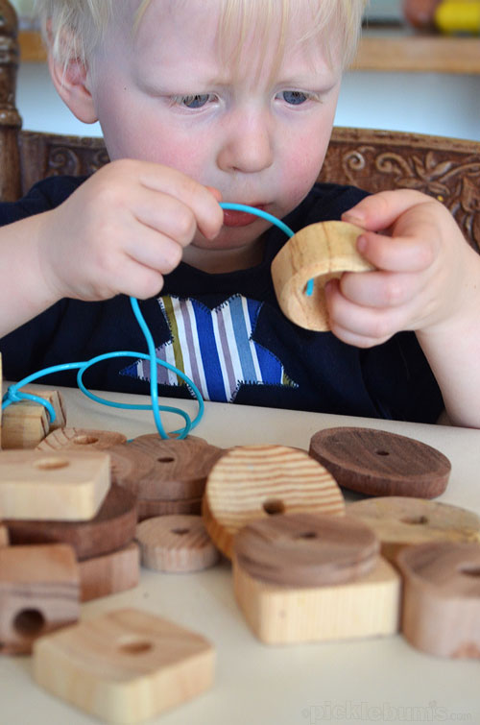
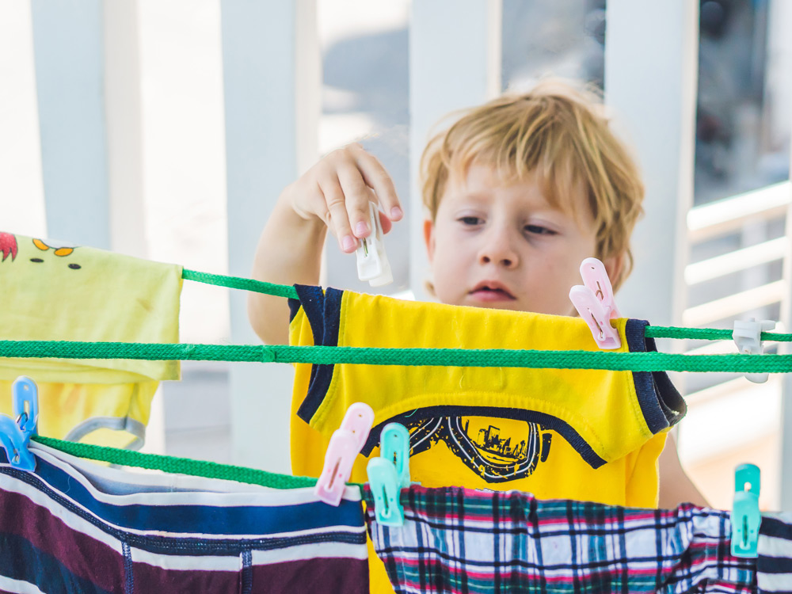
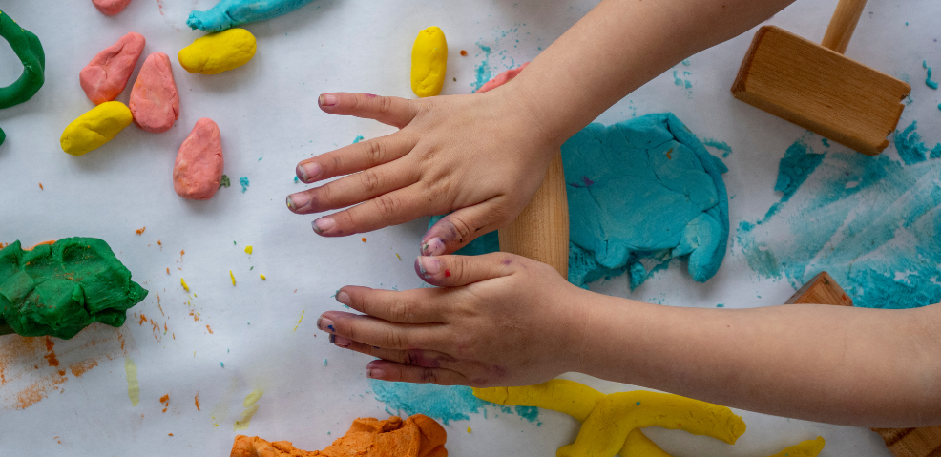
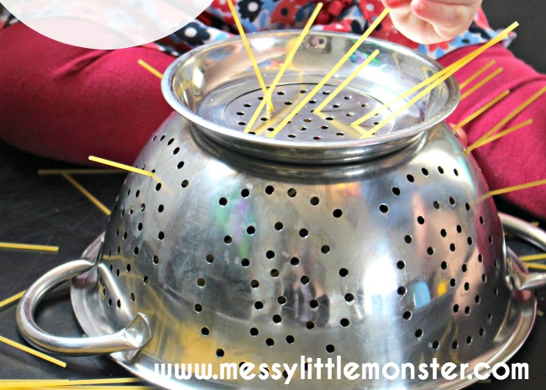
How can I help at home?:
Read phonics book daily with your child at home and record in the diary. Read to your child regularly and talk about books.
Talk about the phoneme learnt each day.
Encourage children to speak in full sentences.
Encourage large drawing activities which strengthen gross motor skills.
Look for opportunities to develop fine motor control.

