Slide 1

Teaching Mathematics at Charlton Kings Infants’ School
Parent Workshops
September 2026

Slide 2
Aims of the Session:
To understand the expectations by the end of YR
To understand how mathematics is taught at CKIS
To understand how to support children’s learning at home

Slide 3
Introduction:
Mathematics is a ‘Specific Area of Learning’ in the Early Years Foundation Stage.
Mathematics is broken up into two Early Learning Goals (ELGs). These are: ‘Number’ and ‘Numerical Patterns’.

Slide 4
Number ELG
(Expectation by the end of the year):
Children at the expected level of development will:
Have a deep understanding of number to 10, including the composition of each number;
Subitise (recognise quantities without counting) up to 5;
Automatically recall (without reference to rhymes, counting or other aids) number bonds up to 5 (including subtraction facts) and some number bonds to 10, including double facts.

Slide 5
Numerical Patterns
(Expectation by the end of the year):
Children at the expected level of development will:
Verbally count beyond 20, recognising the pattern of the counting system;
Compare quantities up to 10 in different contexts, recognising when one quantity is greater than, less than or the same as the other quantity;
Explore and represent patterns within numbers up to 10, including evens and odds, double facts and how quantities can be distributed equally.

Slide 6
Areas of mathematics covered through the year:
Counting
Ordering
Sorting
More/Less
2D/3D Shapes
Length/Height
Repeating patterns
Estimating
Addition
Subtraction
Mass
Handling Data
Position/Distance
Money
Number Facts
Capacity
Time
Counting in 2s, 5s, & 10s
Symmetry
Ordinal Numbers…….

Slide 7
A Number Rich Environment:
Numbers can be found everywhere in the Reception environment:
Incorporated into sand/water play
Number lines/tracks
Playground markings
Role play areas (tills, numbered toys etc.)
Timers
Songs/routines/rhymes
Etc…

Slide 8
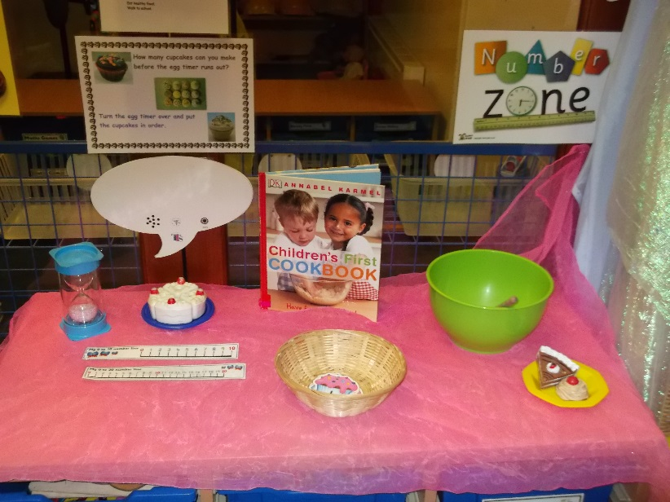
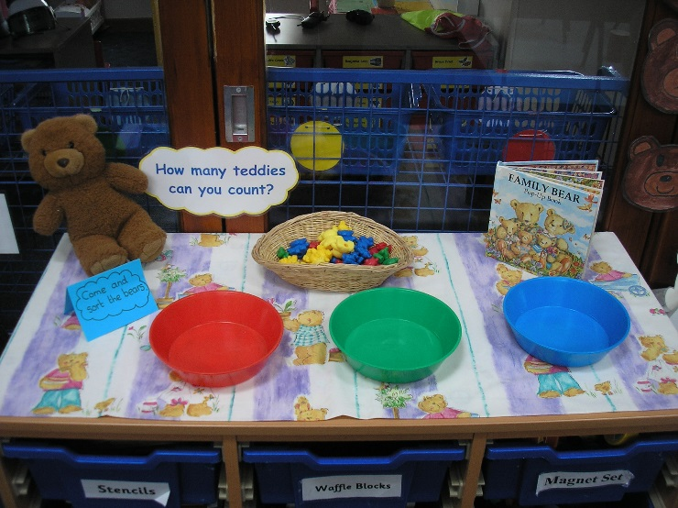
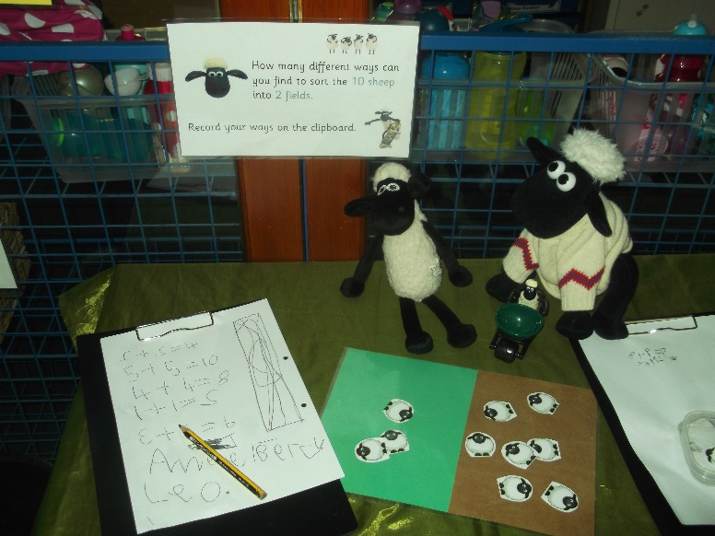
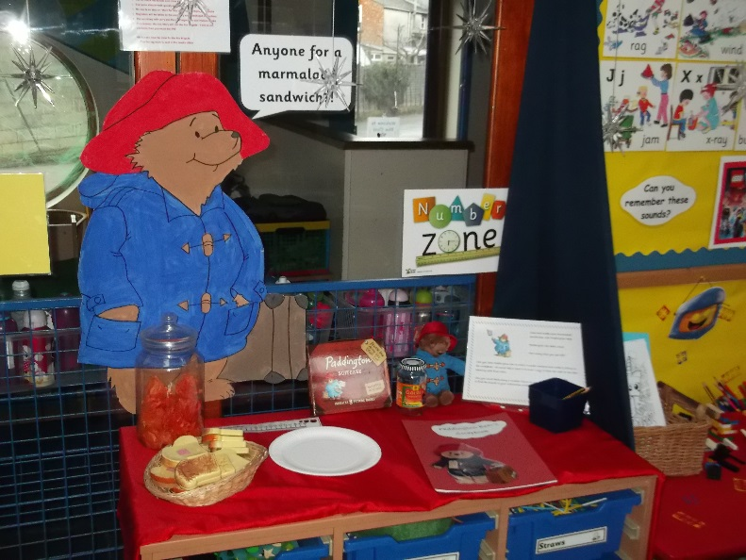
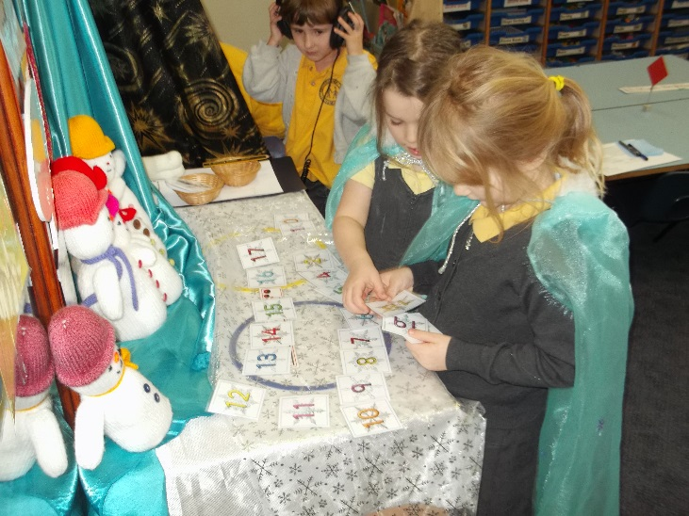
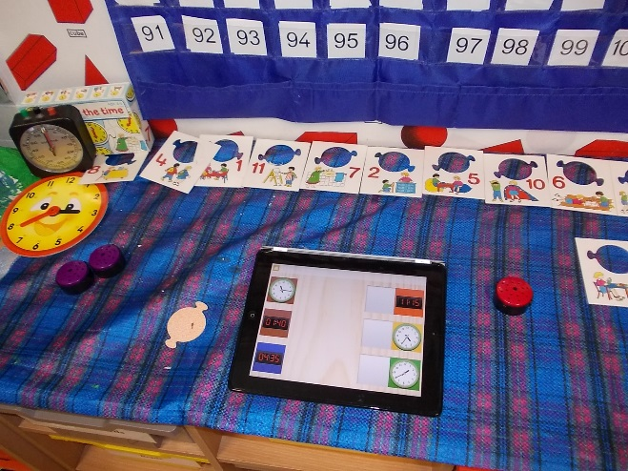
A Number Rich
Environment

Slide 9
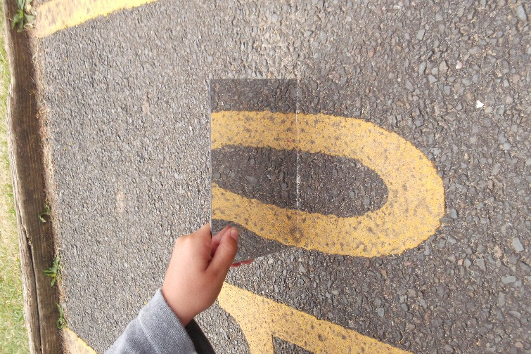
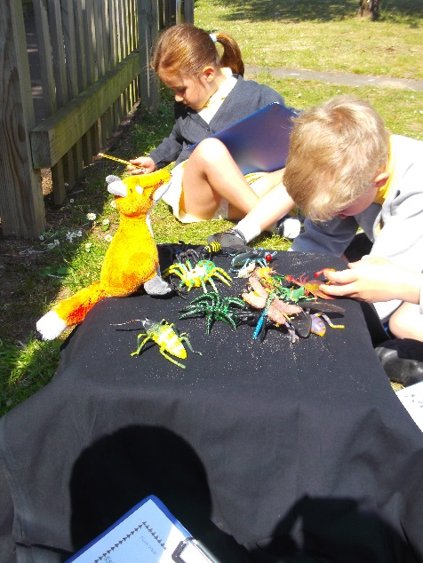
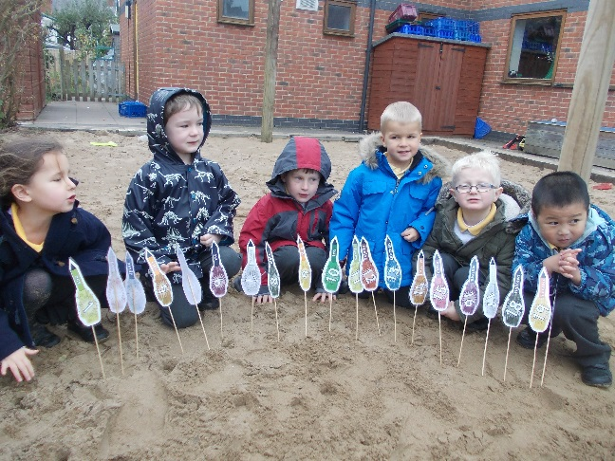
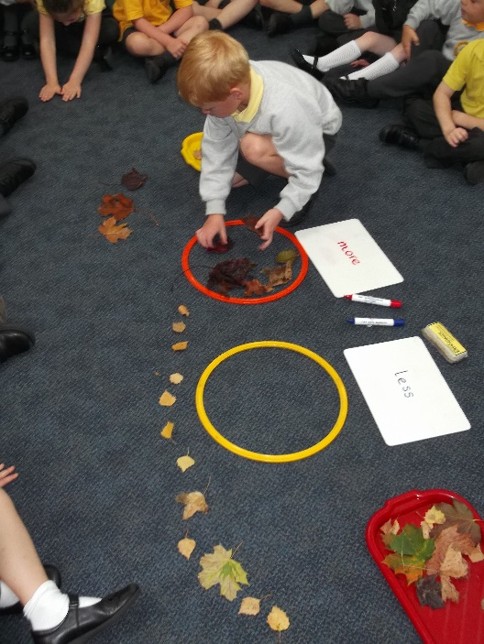
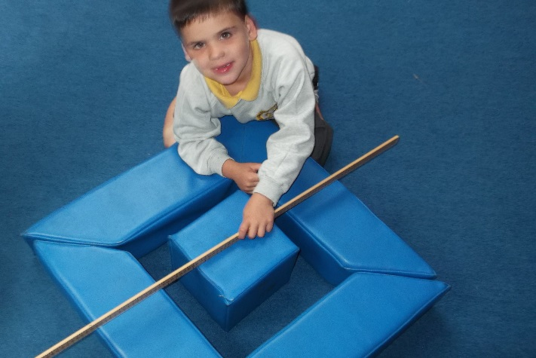
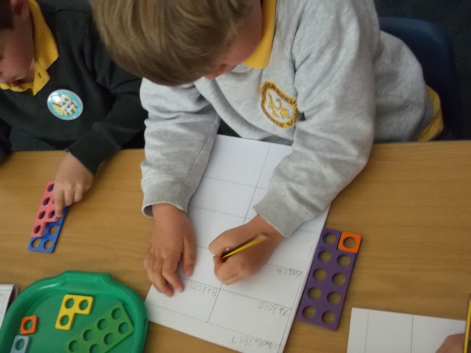
Making Mathematics Fun

Slide 10
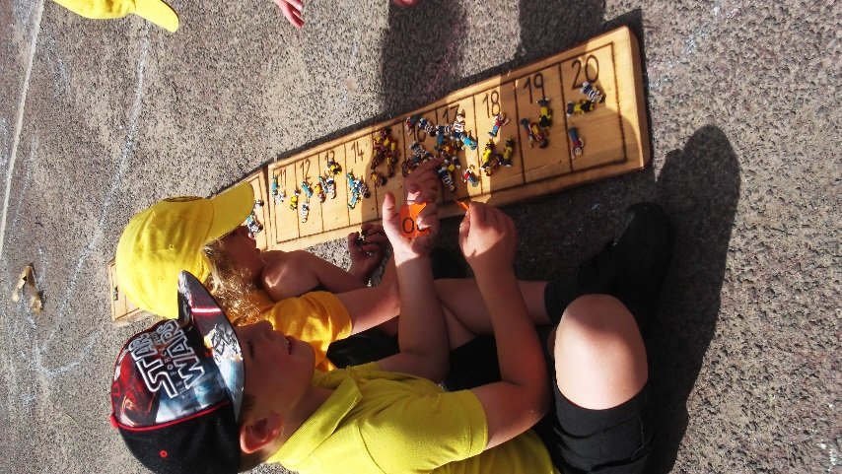
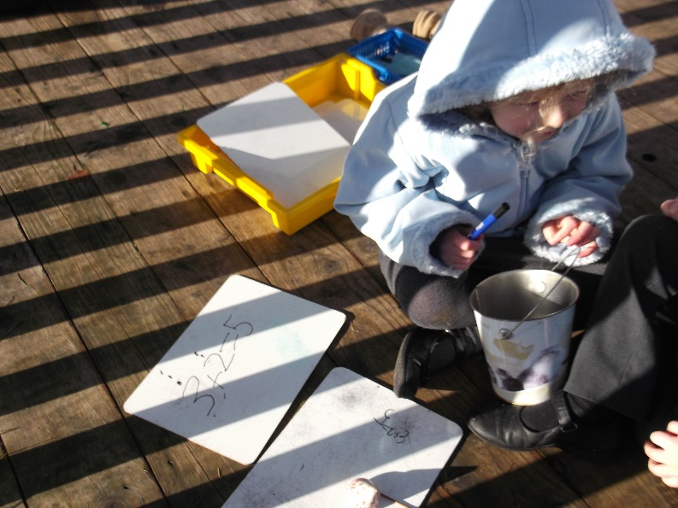
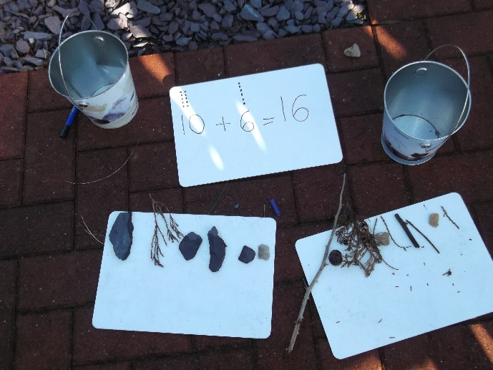
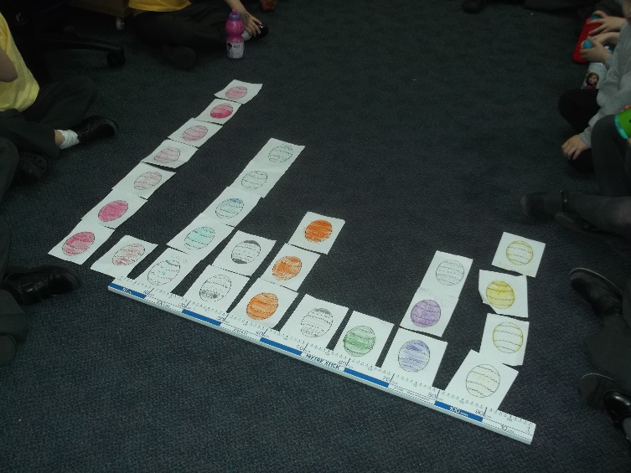
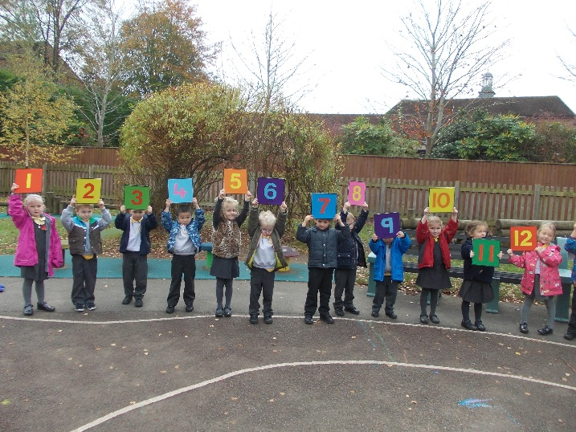
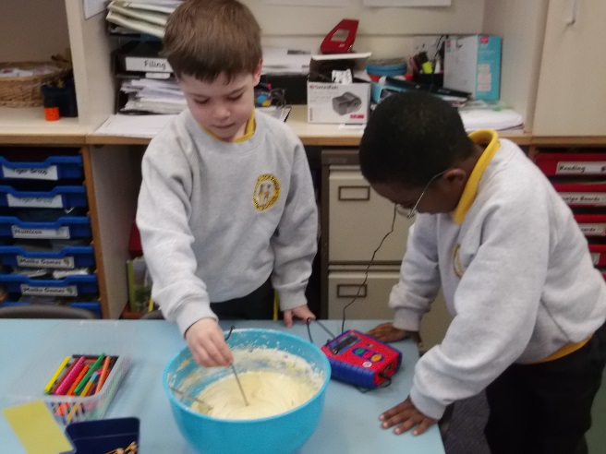

Slide 11
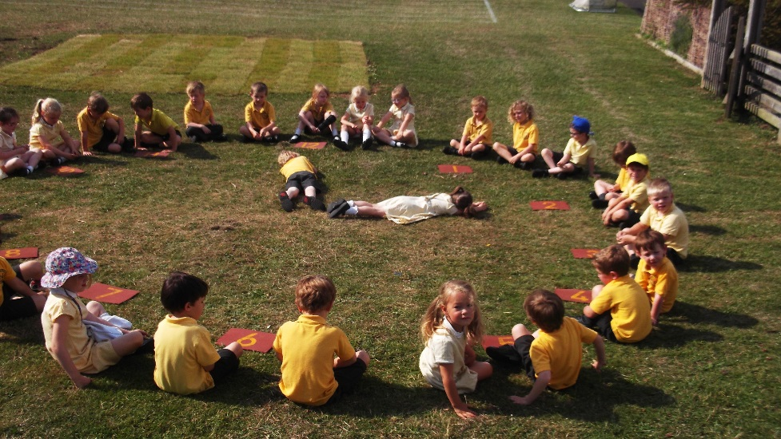
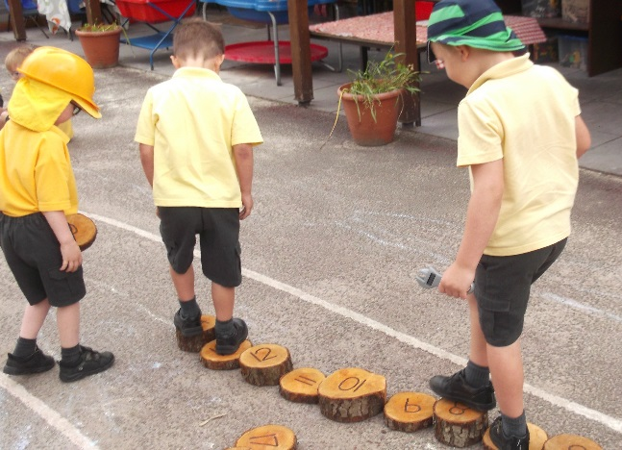
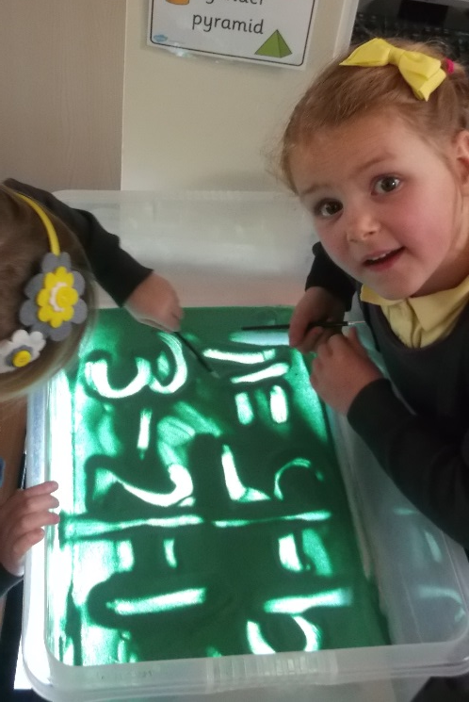
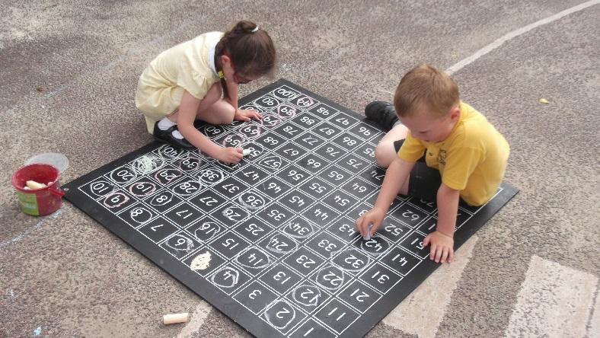
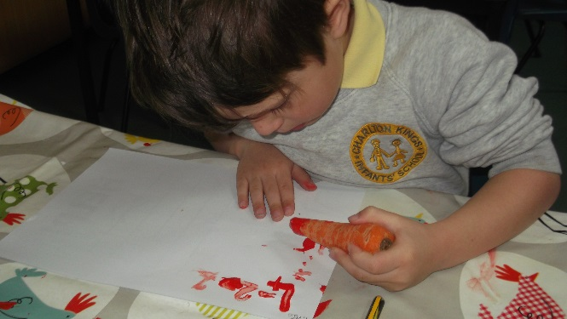

Slide 12
How we Approach Mathematics in Reception at Charlton Kings Infants’ School:
We teach number through four sessions during the week following the NCETM (National Centre for Excellence in the Teaching of Mathematics) scheme Mastering Number. The children know this as: Magic Maths.
The NCETM is taught using a range of practical and engaging resources (rekenreks, reversible counters, number blocks (BBC))
We also have two additional mathematics sessions per week. During these sessions we focus on reinforcing learning, practising and applying. Mathematics teaching is usually of a practical nature but does include some recording.
Mathematics is integrated into the whole curriculum and classroom environment.

Slide 13
Can you say it in a different way?
Can you prove it?
Mastery Approach at CKIS
Our questioning
Style encourages deeper level thinking
How do you know?
True or false…?
Convince me…
If we know that, what else do we know?
Can you show me in another way?

Slide 14
We foster a positive attitude towards mathematics.
THE POWER OF ‘YET’
We can’t do it… YET!

Slide 15
Some children may have worked on the following at nursery/pre school/Kindergarten:
Recite numbers past 5 and say one number for each item in order: 1,2,3,4,5.
Know that the last number reached when counting a small set of objects tells you how many there are in total (‘cardinal principle’).
Talk about and explore 2D and 3D shapes (for example, circles, rectangles, triangles and cuboids) using informal and mathematical language: ‘sides’, ‘corners’; ‘straight’, ‘flat’, ‘round’.
Understand position through words alone – for example, “The bag is under the table,” – with no pointing.
Make comparisons between objects relating to size, length, weight and capacity.
Talk about and identify the patterns around them. For example: stripes on clothes, designs on rugs and wallpaper. Use informal language like ‘pointy’, ‘spotty’, ‘blobs’, etc.
Extend and create ABAB patterns – stick, leaf, stick, leaf.
Statements taken from Development Matters (Mathematics 3 – 4 years old)

Slide 16
How can I help at home?:
Sing maths songs/nursery rhymes (e.g. one, two, three, four, five, once I caught a fish alive, five little speckled frogs, one two buckle my shoe, ten green bottles)
Practise recognising numerals to 20 (e.g. house numbers, number plates, signs, television, old telephones, remotes)
Practise ordering numbers to 20 (e.g. numbered cars in a car park, bath time foam numbers)
Use construction equipment to build models and discuss 3D/2D shapes
Go on shape hunts around the home/outside
Use coins when shopping/spot price tags etc.
Counting up and down the stairs (forwards and backwards)
Using timers to measure activities
Cooking together and weighing ingredients
Pattern spotting (e.g. colours, shapes, objects)

Slide 17
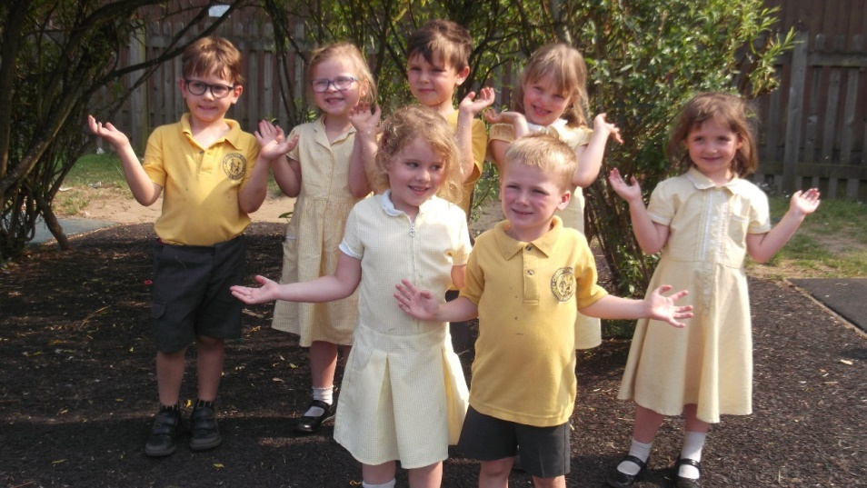
Any questions?

