Slide 1
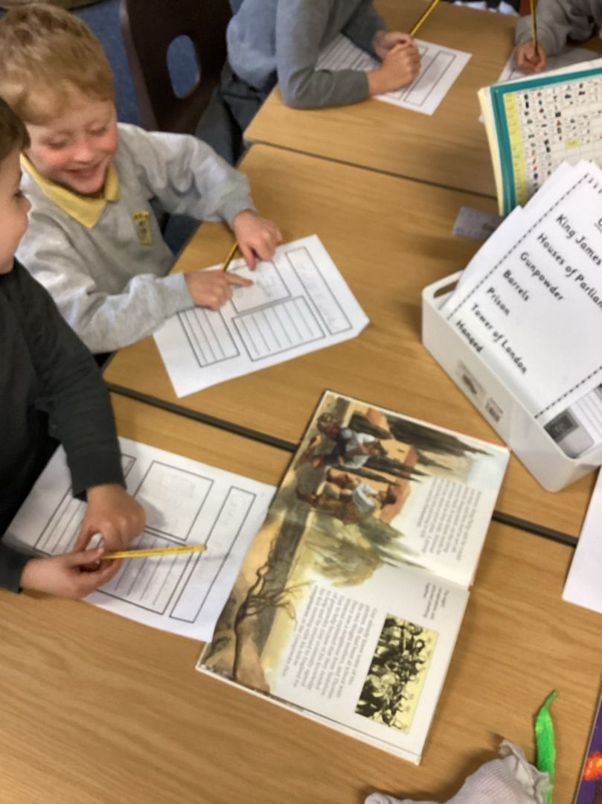
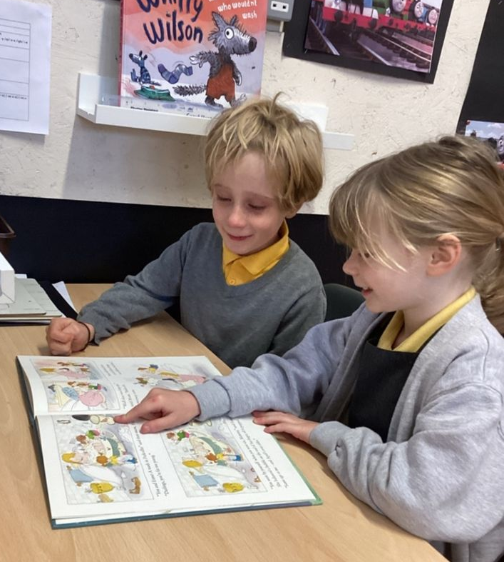
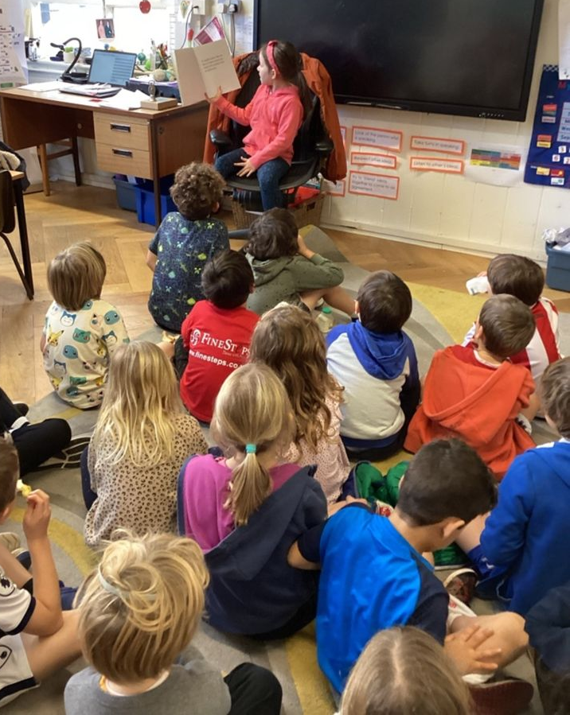
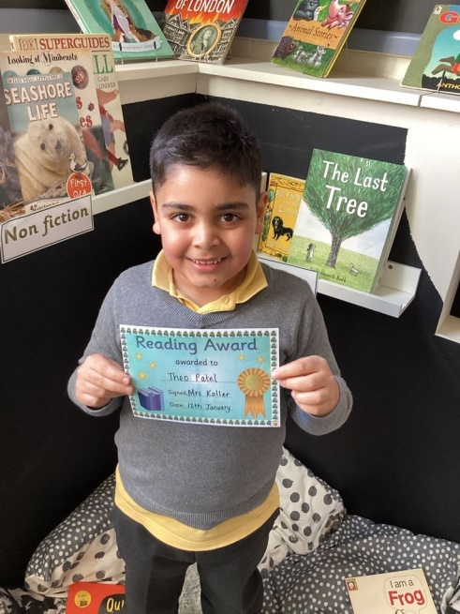
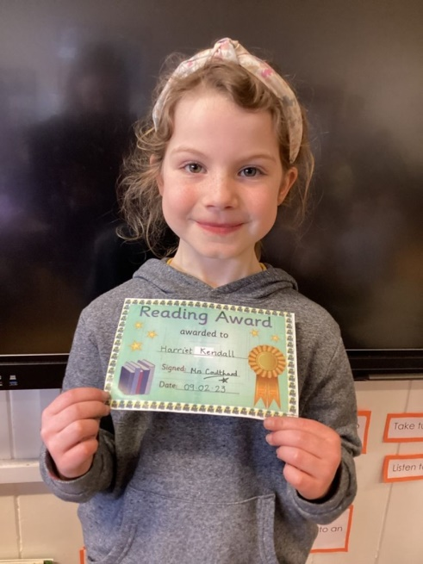
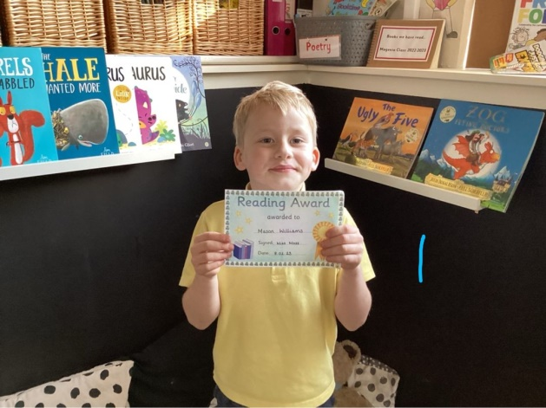
PHONICS &Reading in Y2
September 2025

Slide 2
Phonics - The latest guidance in England:
Teachers advised to use Systematic, Synthetic Phonics programmes and ‘cumulative’ decodable reading books for beginners

Slide 3

Our school uses the
Phonics International programme
www.phonicsinternational.com

Slide 4
The Synthetic Phonics Teaching Principles
Teach:
KNOWLEDGE of the ALPHABETIC CODE
= letters linked to the sounds of speech
THREE CORE SKILLS
  ‘sounding out and blending’ for reading
  identifying sounds in words for spelling
  handwriting

Slide 5
What is the alphabetic code?
Letters and letter groups are code for the individual sounds in our speech.
Decoding the letter symbols into sounds is the basis for reading:
See the printed word soap, say the sounds
/s/ /oa/ /p/, blend the sounds to read (or discern) “soap”

Slide 6
Phonics in Y2
Continuation from Y1
X2 Phonics lessons a week
Revising alternative graphemes /ai/ /ee/ /ie/ /oa/ /ue/
Revise any gaps in GPCs using our phonics tracking system
New unusual GPCs e.g /ai/ eigh /oa/ eau
Regular spelling lessons
Weekly links via seesaw to support weekly phonics learning

Slide 7
Children need to apply growing phonics knowledge and skills to words, sentences and texts for reading, spelling and writing
As children progress through Y2 they will move from decoding to reading with fluency and expression. (x90 words per minute) Children will need to reread sentences and books over and over to gain confidence and fluency.

Slide 8
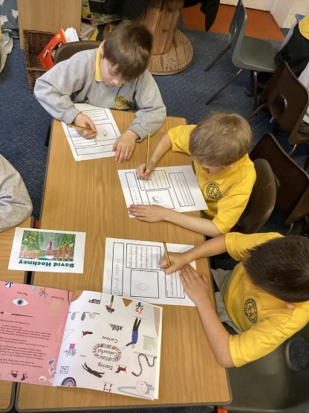
Reading in Y2
Daily ERIC time
Daily whole class story time – fiction/nonfiction
Individual reading with member of staff – aim for x1 a fortnight minimum
X2 Guided Comprehension (VIPERS) sessions per week
All children take home a school reading book and a ‘Dream Read’
We welcome book recommendations for all children
Reading Champion every week
We have an open book corner
High quality texts for each foundation subject
World Book Day
Library visits
Birthday books

Slide 9
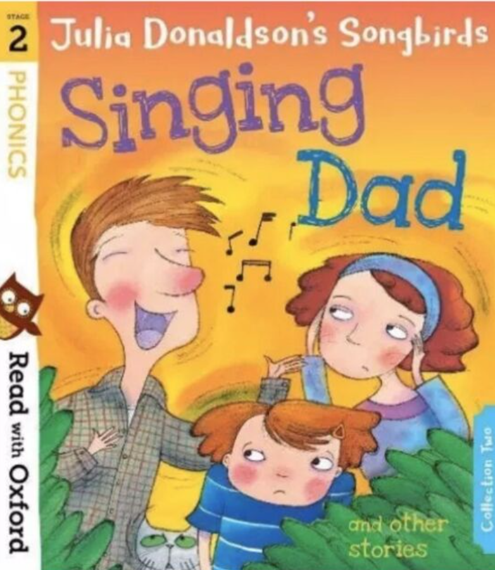
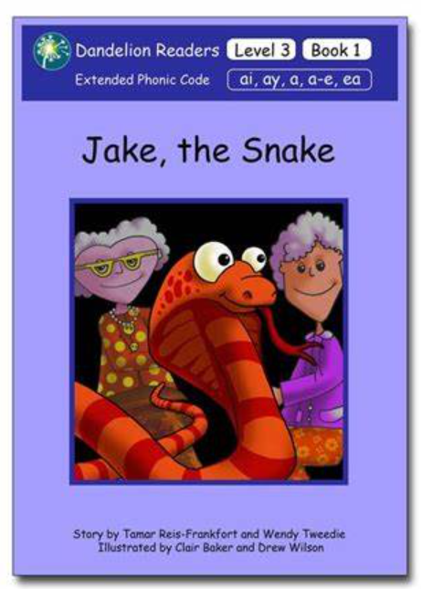

READING BOOKS
‘Tree’ books
These books should be just below the children’s phonic ability and contain digraphs which the children have a secure understanding of. The children should be able to read these books with increasing fluency.
Phonetically decodable books which directly linked to the phonics being taught or revised.
These are sometimes repeated, depending on whether the class/individual children are struggling with specific digraphs.
Dream Reads
The children read a range of high-quality fiction and non-fiction texts during ERIC time.
They can choose one they like to share with you at home.

Slide 10

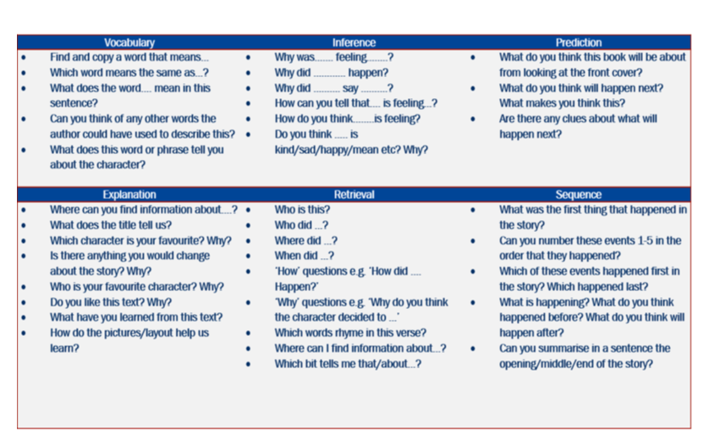
How do we support children's comprehension?
During individual reading sessions, class story time sessions and Guided Comprehension sessions we ask children questions like these. This will continue in Y3

Slide 11
What can we do to help at home?
Read with your child EVERY day!
Record all reading at home in their reading diary
Read to them – share longer texts and discuss the story –prediction, sequencing etc. VIPERS
Listen to audio stories and discuss
Read when you are out and about – menus, signs, recipes, road signs etc.

Slide 12
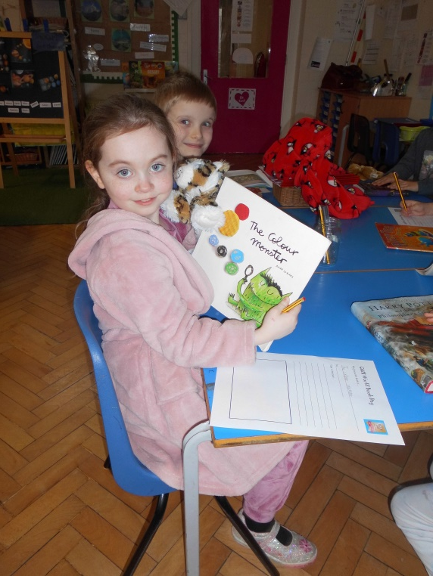
The more that you read, the more things you will know. The more you learn, the more places you will go." Dr Seuss
The National Literacy Trust has noted that becoming a lifetime reader is based on developing a deep love of reading.

