Slide 1
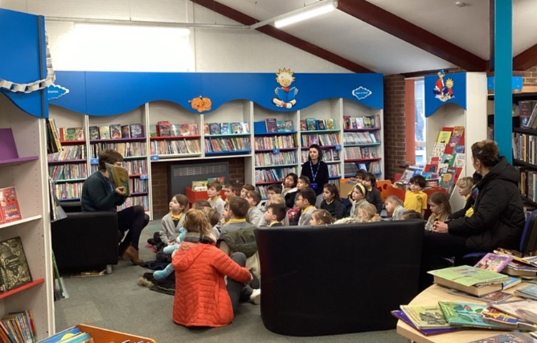
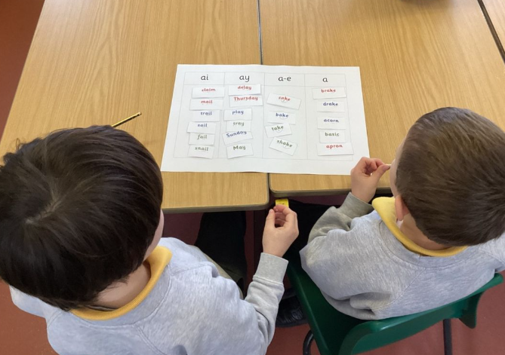
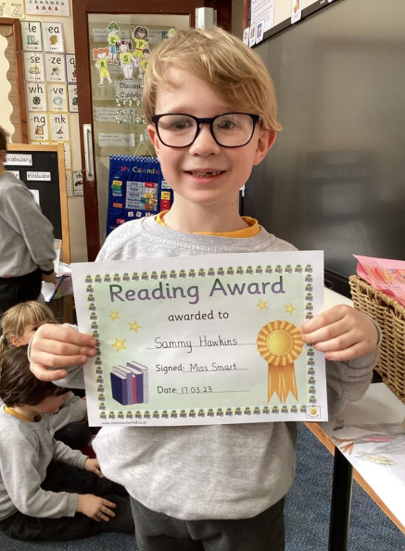
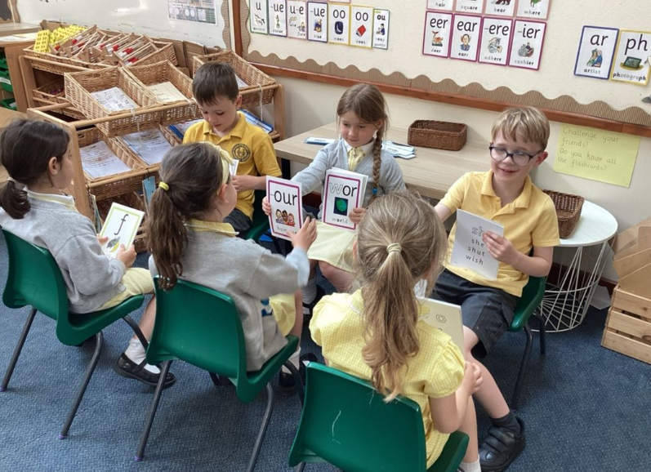
PHONICS & Reading in Y1
September 2025

Slide 2
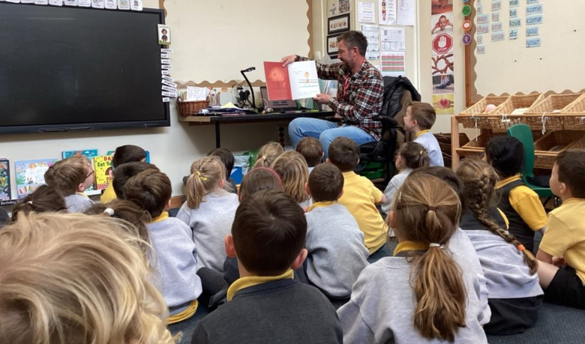
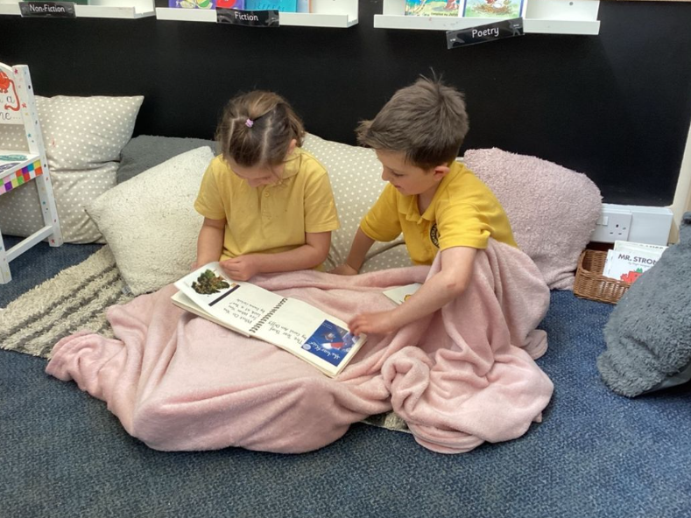
“The more that you read, the more things you will know. The more you learn, the more places you will go."
Dr Seuss
The National Literacy Trust has noted that becoming a lifetime reader is based on developing a deep love of reading.

Slide 3

Our school uses the
Phonics International programme
www.phonicsinternational.com

Slide 4
The Synthetic Phonics Teaching Principles
Teach:
KNOWLEDGE of the ALPHABETIC CODE
= letters linked to the sounds of speech
THREE CORE SKILLS
  Decoding - ‘sounding out and blending’ for reading
  Encoding - identifying sounds in words for spelling
  Handwriting

Slide 5
What is the alphabetic code?
Letters and letter groups are code for the individual sounds in our speech.
Decoding the letter symbols into sounds is the basis for reading:
See the printed word soap, say the sounds
/s/ /oa/ /p/, blend the sounds to read “soap”

Slide 6
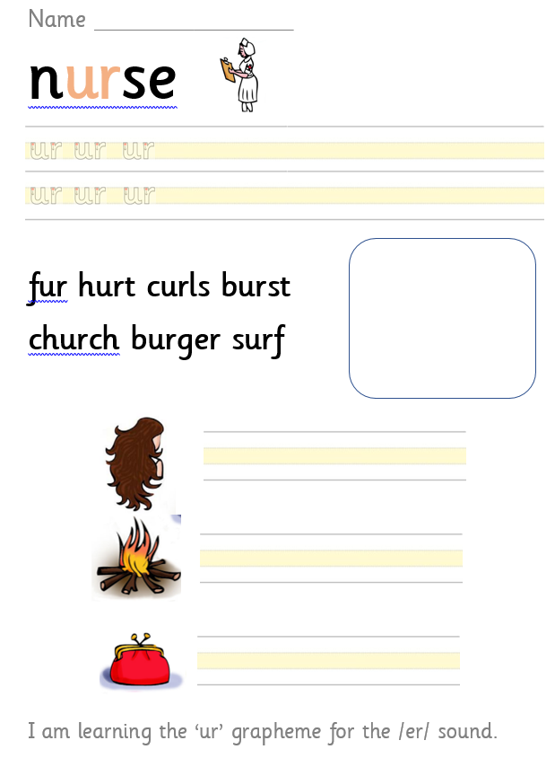
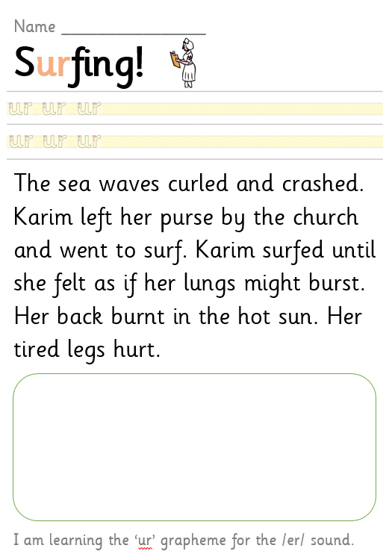
Our phonics sheets

Slide 7
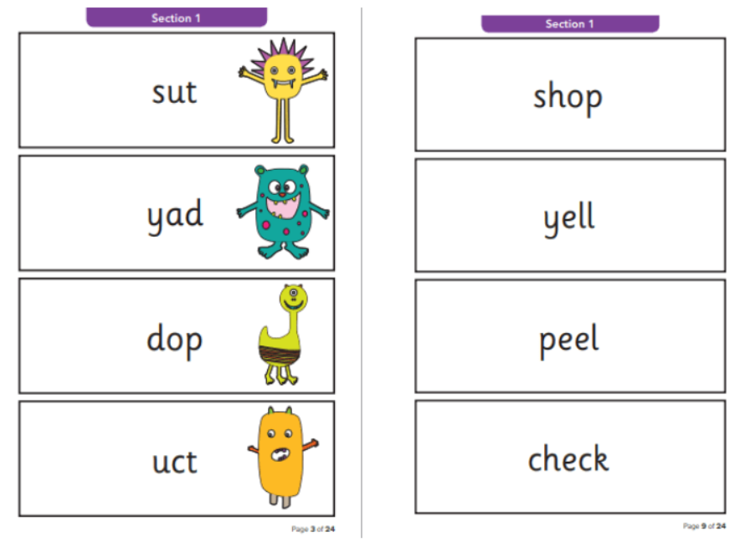
Phonics screening check
In June, all Year 1 children will undertake a phonics screening check, to assess the standard of their decoding and blending skills.
The test contains 40 real and ‘alien’ words for the children to read.
The results are used to analyse the school’s performance. The results won’t have any impact on your child so please do not worry!
If your child does not reach the pass mark (which is usually 32/40), then they can retake it in Year 2.

Slide 8
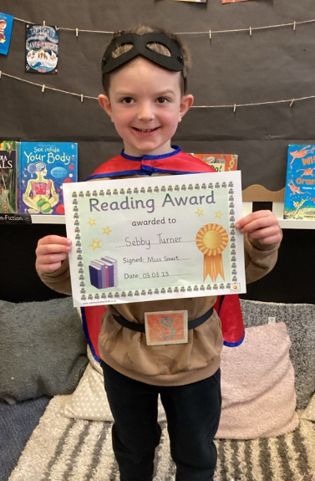
Reading at CKIS
Daily ERIC time
Daily whole class story time – fiction/nonfiction
Individual reading with member of staff – aim for x1 a week
X2 Guided Comprehension (VIPERS) sessions per week (Summer term)
‘Dream Reads’ book to take home
Birthday books – Amazon wish list (we will be updating this!)
Reading Champion every week
We have an open book corner
High quality text for each foundation subject
World Book Day
School library

Slide 9

Reading books
‘Tree’ books
These books should be just below the children’s phonic ability and contain digraphs which the children have a secure understanding of. The children should be able to read these books with increasing fluency.

Slide 10
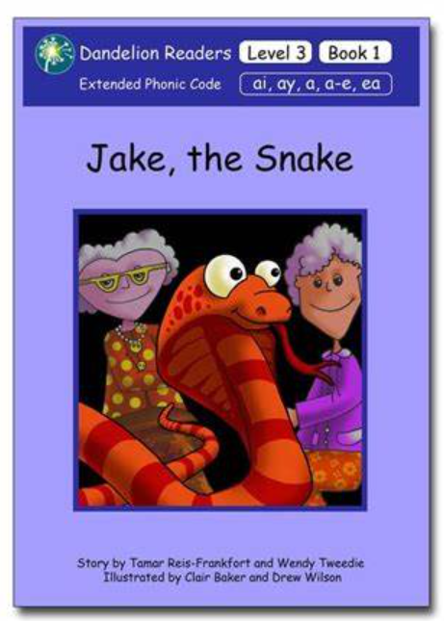

Reading books
Phonetically decodable books which directly link to the phonics being taught in school that week.
These are sometimes repeated, depending on whether the class/individual children are struggling with specific digraphs.

Slide 11

Reading books
Dream Reads
The children read a range of high-quality fiction and non-fiction texts during ERIC time.
They can choose one they like to share with you at home!

Slide 12
What can we do to help at home?
Year 1 is a “bridge to fluency” so we are aiming for the children to move on from blending individual sounds into a word to being able to read a whole word and then sentences fluently.
To support this at home, we need to encourage children to re-read words and sentences back.
Read with your child EVERY day
Record all reading at home in their reading diary
Read to them and talk about the story
Read when you are out and about – menus, signs, recipes, road signs etc.
Revisit the phonics folders regularly at home
Use the weekly Wand phonics links

