Slide 1


Charlton Kings Infants’ School &
Charlton Kings Junior School
How to support your child’s wellbeing
Welcome and introduction | Sue Selwood Katie James | Headteachers
A Guide to Supporting Well-being in (ourselves and) Our Children | Nick Jukes Sarah Pritchard Emma Turner Helen Fitzsimmons | CKJS CKIS CKIS CKJS
Mindfulness and relaxation strategies | Nicola Gibbons | Pastoral Support, CKJS
Notes:
SS

Slide 2
Welcome
Sue Selwood Headteacher, CKJS
Katie James Headteacher, CKIS
Two schools, one journey (increasingly three schools, one journey)
Notes:
SS/KJ

Slide 3
Who can you speak to at school?
Charlton Kings Infant School
Firstly, your child’s class teacher
Emma Turner
Sarah Pritchard
Charlton Kings Junior School
Firstly, your child’s class teacher
Nick Jukes
Helen Fitzsimmons
Nicola Gibbons
Notes:
SS/KJ

Slide 4
Mindfulness and relaxation techniques
Nicola Gibbons, Pastoral support, CKJS
Notes:
NG

Slide 5
Supporting Well-being in Our Children
Notes:
SS

Slide 6
Know your child and their likes/dislikes
Help them to develop a positive identity of themselves.
  Self belief
  Accepting themselves
  Liking themselves
Give confirmation of the things they enjoy and do well.
Think – are you being a positive role model. Do you like yourself?
Think –Do you show you like them and what they do?
Notes:
KJ

Slide 7
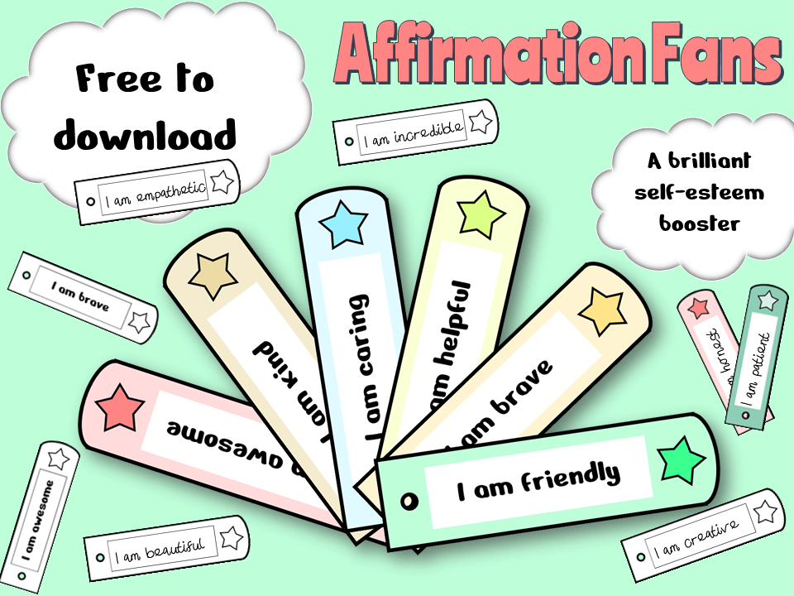
www.elsa-support.co.uk
Notes:
KJ

Slide 8
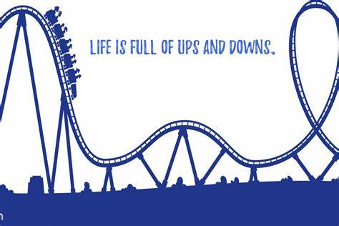
Try not to worry about your child and try not to overprotect them ..
Help them to develop resilience:
  They need to experience things that don’t go well so they can cope with future challenges.
Notes:
SS

Slide 9
Experiencing some anxiety is normal!
Children need to get things wrong sometimes.
They need to find some things a challenge.
They need to experience some disappointments.
They need to fail occasionally.
You are their best role model – how you act and cope shows them how to do it too. Talk about your feelings and how you support yourself.
Don’t always give them what they want – say ‘no’ sometimes …
Notes:
SS

Slide 10
But, be careful what you share …
Whilst it can be good to model how you cope with difficulties, remember, your child is still a child.
Sometimes when adults are finding things tricky, such as when experiencing relationship difficulties, illness or bereavement it can be easy to use your child as a support but this can be very difficult for them to manage, because they take on your worries.
Notes:
SS

Slide 11
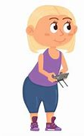
Control
We all need some element of control in our lives and for children this can be a challenge, because there will be things they won’t be able to control.
Children will push the boundaries you set, but it is important to be consistent as parents/carers with what you will allow and not.
  Consistent boundaries help children to feel safe.
Giving choices can be a good way to give your child some control, but be careful not to give too many, as this can be overwhelming.
Notes:
KJ

Slide 12
Chores – a great way to show your child you trust them!
Research has show that children benefit from being given age-suitable chores:
  ‘Children who have a set of chores have higher self-esteem, are more responsible, and are better able to deal with frustration and delay gratification, all of which contribute to greater success in school’.
    The Benefits of Chores from The Center for Parenting Education
Giving children chores teaches them responsibility and, if they make mistakes, they can learn from them - with your support.
Notes:
KJ

Slide 13
Age | Some Suggested Chores
2 - 4 | Feeding a pet Tidying away toys Placing dirty washing in the basket Dusting surfaces
4 - 8 | All the previous chores and .. Make their bed Help load/empty the dishwasher Help carry in some of the groceries Water plants Help sort clean washing eg pair socks Care for an animal Tidy their room Clean/wipe surfaces Empty bins
8 - 12 | All the previous chores and .. Load/empty the dishwasher Wash the car Load/empty the washing machine/dryer Take rubbish/recycling to the bins Put the bins out Sweep floors/hoover
Notes:
KJ

Slide 14
Acknowledge, and help your child describe their emotions …
Teach them about different feelings and emotions and what they are called.
Teach them how their body might be feeling with different emotions (fidgety, butterflies, nauseous ..)
Let them know that everyone experiences different emotions at different times and that all emotions are important.
Teach them that nobody is happy all of the time, we all feel sad, anxious, worried, angry, and so on, sometimes.
The films Inside Out and Inside Out 2 are great for supporting this understanding.
Notes:
ET
Mention about affirming feelings … ‘I can see you’re …. angry/upset’ etc

Slide 15
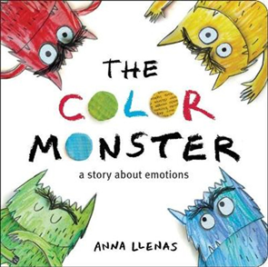
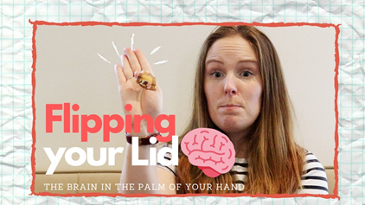
Understanding and supporting age and stage appropriate emotions
Let's talk about emotions!!
Notes:
ET

Slide 16
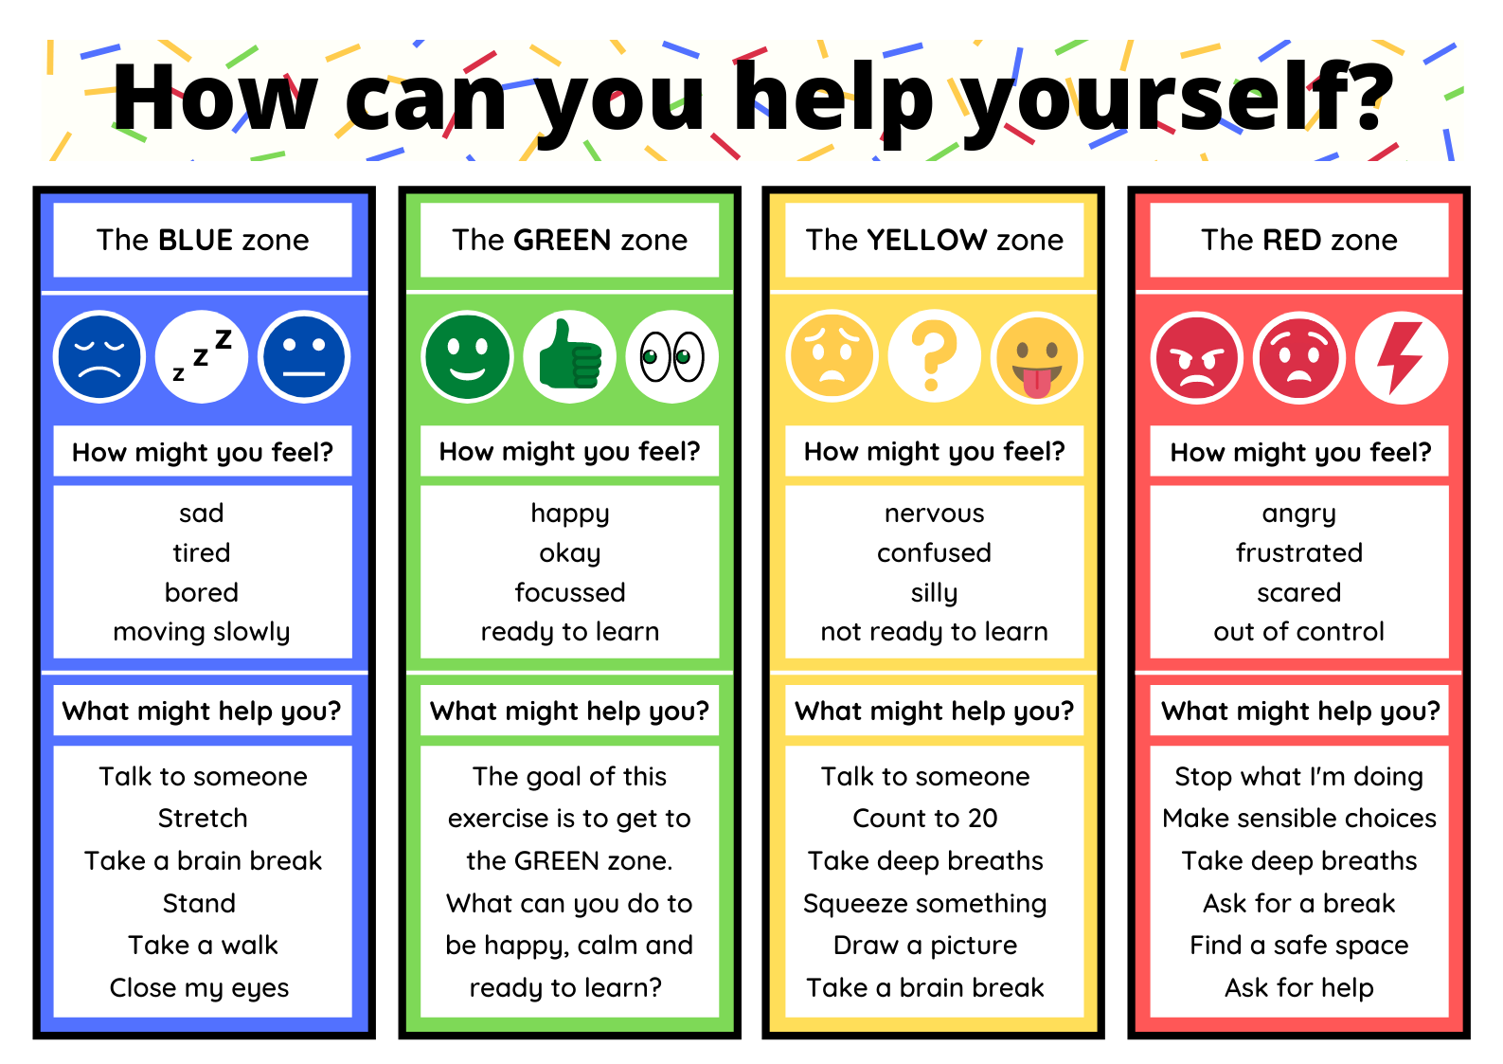
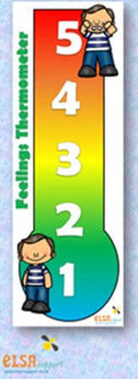
Notes:
ET/NJ

Slide 17
How the colours are used in school
Children learn about the emotions associated with each colour.
They understand that there are no ‘bad colours’, but that by self-regulating they can be green or move to green from a different colour.
They are able to label the emotions they’re feeling and have the tools they need to move themselves towards being green.
They understand that this is for all children to use at school and at home.
Notes:
NJ

Slide 18
How you can support your child and help them with their emotions:
Sometimes just being there is enough (a hug or a cuddle).
Let them know everyone experiences negative emotions sometimes and they will pass.
If children are 'red’, or at a ‘5’, give them space and time - they will be unable to reason until they are calm again (this can take a long time).
Once they are calm, you could try exploring with them what tipped them into red (but not too soon as doing this could tip them into red again). It might be best to wait until the next day and they might not actually know!
It is said the ability to self-regulate does not fully develop until the age of 25, which is why teenagers often seem like they are behaving like toddlers emotionally!
Notes:
NJ

Slide 19
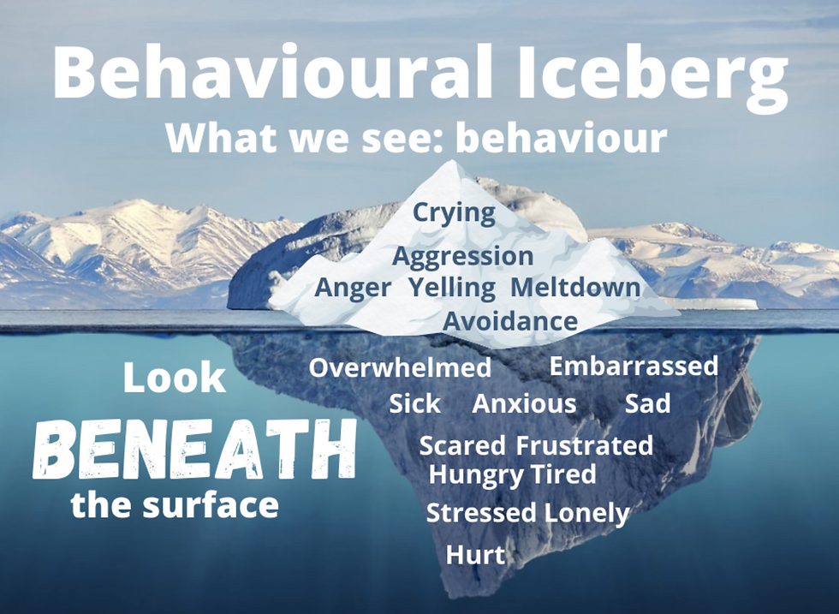
If you think of behaviour as a way in which children communicate, then it can be helpful to view 'bad' behaviour' as a child's way of trying to express their feelings which we are unable to see.
Notes:
SP

Slide 20
Respect
It is easy to be critical of others, especially if their child’s behaviours are impacting on your child’s well-being.
  But why is that child behaving like that?
We teach the children to be respectful and tolerant of others – as well as a British value, these are important lifeskills if they are to thrive in a complex and diverse world.
  Empathy, showing understanding, sharing are all important attributes for children to learn.
Are you modelling respect and tolerance to your child?
Imagine if your child struggles because they are anxious, overwhelmed or have an additional need which makes understanding social cues difficult. You would want other adults to empathise and show you respect. Do you do this towards other parents?
Notes:
KJ

Slide 21
Slow down and play
Like adults, children need time and space to be children, to do what they like doing.
Modern life is so busy it can be overwhelming – think about how much your children do.
We need to give children time just to play:
  Playing outside, being with their friends, time to sit and read or just draw.
  There is a difference between structured play (activities) and unstructured play. Children need to learn to entertain themselves, to use their imagination.
Are your children doing too many things?
If we always organise activities for children to do (or structure their play), they will never learn to cope with boredom.
Notes:
SS

Slide 22

We need to let children be bored sometimes!!!
Notes:
SS

Slide 23
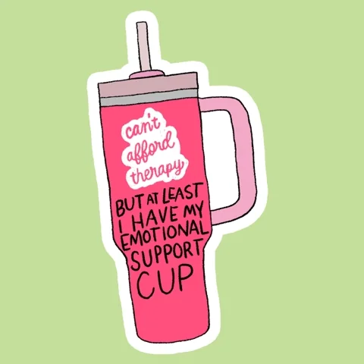
Make time to connect
Spending time with others, talking, one-on-one time are really important for a child’s wellbeing.
Everyone has an ‘emotional cup’ that needs to be filled:
What fills a cup? | What empties a cup?
Love Play Friendship Compliments Affection Connection Achievement Doing things they enjoy | Tiredness Stress Loneliness Rejection Yelling Punishment Failing Being forced to do something
Notes:
SP/KJ

Slide 24
Safe space imagery
Helen Fitzsimmons, Pastoral support, CKJS
Notes:
HF

Slide 25
Thank you
Q&A
Notes:
SS/KJ

