Slide 1

Reading and phonics at Charlton Kings Infants’ School
Parent Workshops
September 2022

Slide 2
Aims of the Session:
To understand the expectations by the end of YR
To understand how reading and phonics is taught in our school
To understand how to support your child’s learning at home

Slide 3
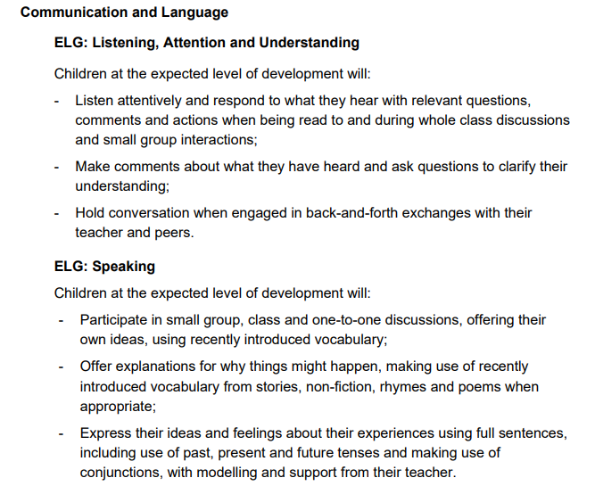
Early Learning Goals

Slide 4
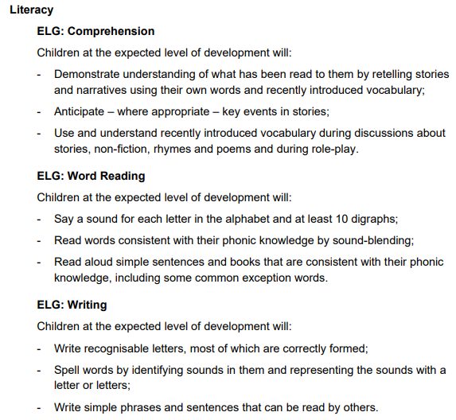
Early Learning Goals

Slide 5
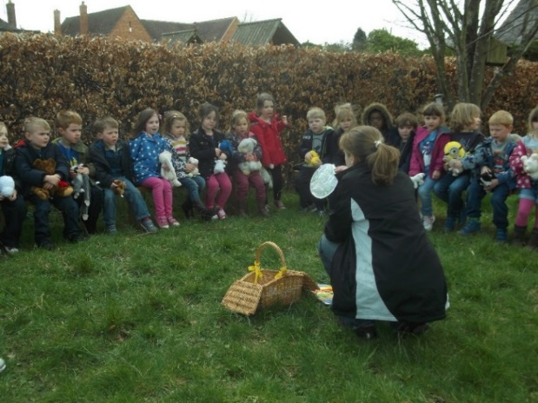
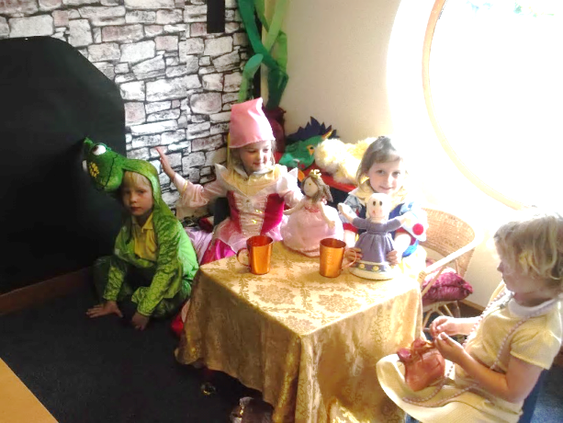
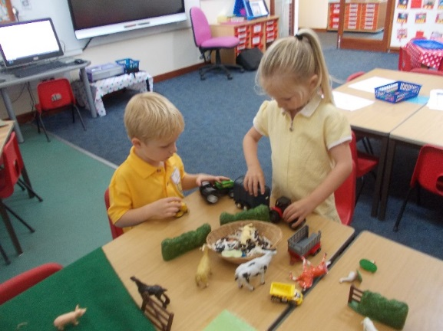
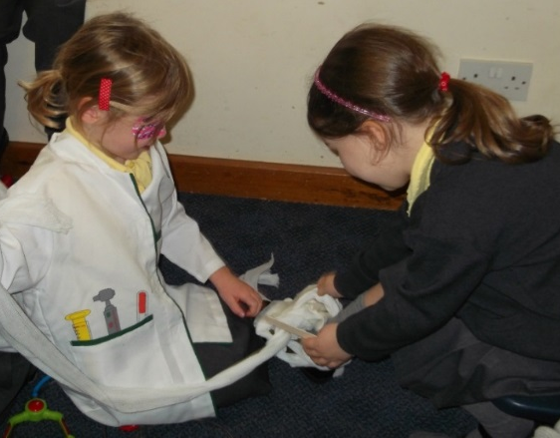
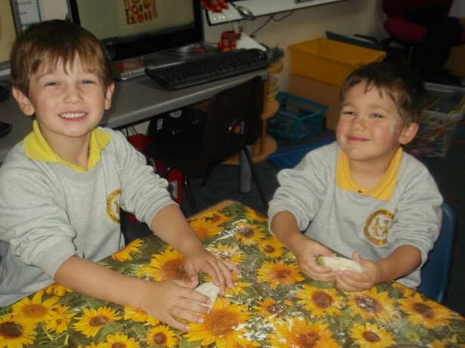
Communication and Language
Notes:
One of the key areas of our EYFS curriculum where reading comes into is…

Slide 6
TALK TALK TALK
There is nothing better than...
shared sustained thinking and talking
Chatter about
anything and everything
with your children!
Notes:
This will help to build up your children’s stock of words and knowledge and understanding of the world – talk improves general comprehension and this will help the ability to read.
'Sustained shared thinking' occurs when two or more individuals 'work together' in an intellectual way to solve a problem, clarify a concept, evaluate an activity, extend a narrative etc. Both parties must contribute to the thinking and it must develop and extend the understanding.

Slide 7
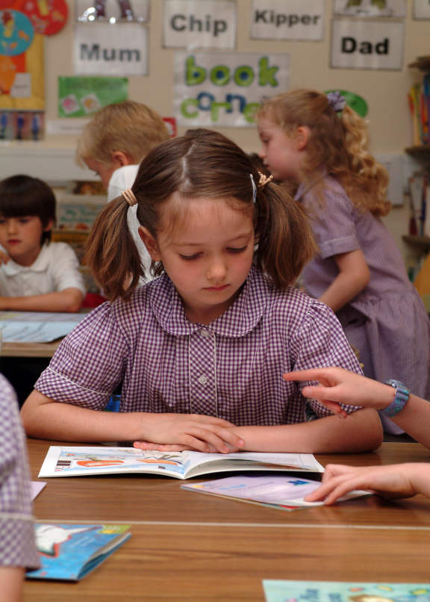

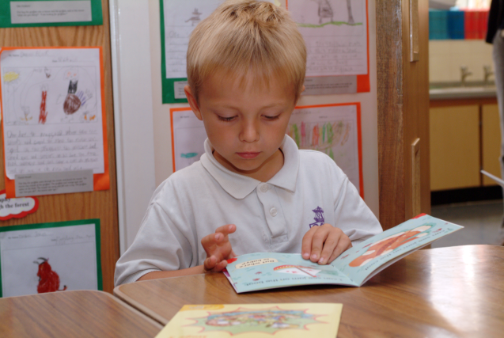
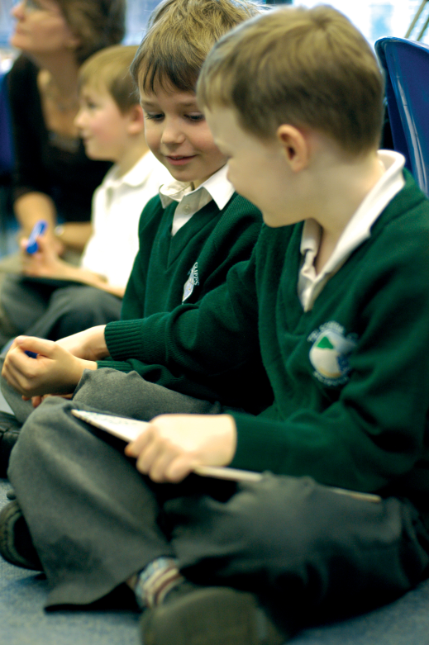


Why are books so important?
Notes:
Creates an interest in hobbies
For entertainment and pleasure
Opens a window on the world (not just for knowledge but also concepts like empathy, understanding, intellect, morals even).
Firing up our imaginations.
Developing vocabulary…
Based on these calculations, here's how many words kids would have heard by the time they were 5 years old: Never read to, 4,662 words; 1-2 times per week, 63,570 words; 3-5 times per week, 169,520 words; daily, 296,660 words; and five books a day, 1,483,300 words.

Slide 8
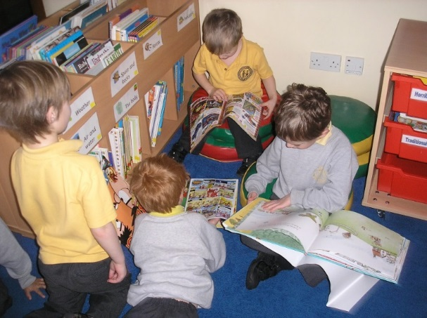
Reading:
Book Corner books
Rhyme of the Week
Shared reading as whole class
Guided comprehension
School library
Visit the local library
Individual reading – reading diaries
School reading books – the comprehension of the story is just as important as the decoding.
Reading and phonics folder
A little every day is key!

Slide 9
Children who
read read read massively increase their vocabulary, knowledge
and understanding
Notes:
The importance of developing a reading culture both at school and in the home cannot be over-emphasised.
Find ways to encourage reading and to establish reading routines at home if possible – for example, reading at bedtime rather than watching that last TV programme!

Slide 10

Our school uses the
Phonics International programme
www.phonicsinternational.com
Notes:
Our school uses the Phonics International programme which is based upon the Synthetic Phonics Teaching Principles.
This teaches beginners the alphabetic code and the alphabet, and the skills of reading, spelling and handwriting and continues as a spelling programme in Key Stage Two.
Parents can hear the sounds and learn about the programme via downloadable resources and video clips at the website.

Slide 11
The Synthetic Phonics Teaching Principles
Teach:
KNOWLEDGE of the ALPHABETIC CODE
= letters linked to the sounds of speech
THREE CORE SKILLS
  ‘sounding out and blending’ for reading
  identifying sounds in words for spelling
  handwriting
Notes:
[You can expand on this: For example: Only new and unknown words need to be sounded out and blended.
Once the sounds have been identified all-through-the-spoken-word, the learner needs to select the correct letters and letter groups which are code for the sounds.
Early handwriting is taught as part of the multi-sensory approach to phonics teaching. Hear the sound, say the sound, write the letter shape or letter group.]

Slide 12
What is the alphabetic code?
Letters and letter groups are code for the individual sounds in our speech.
Decoding the letter symbols into sounds is the basis for reading:
See the printed word soap, say the sounds
/s/ /oa/ /p/, blend the sounds to read “soap”
Notes:
[Model the blending. Make sure that you say pure sounds /s/ /oa/ /p/ with no added ‘uh’ sound on the /s/ and /p/.
The more accurately the sounds are uttered, the more likely the child is to ‘discern’ the focus word.

Slide 13
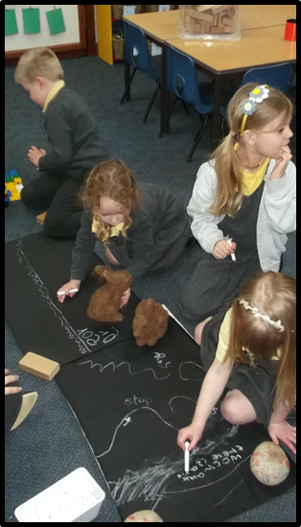
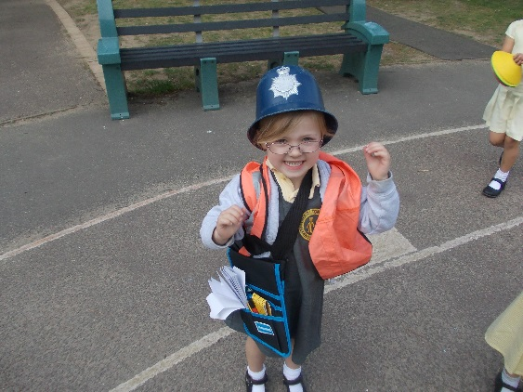
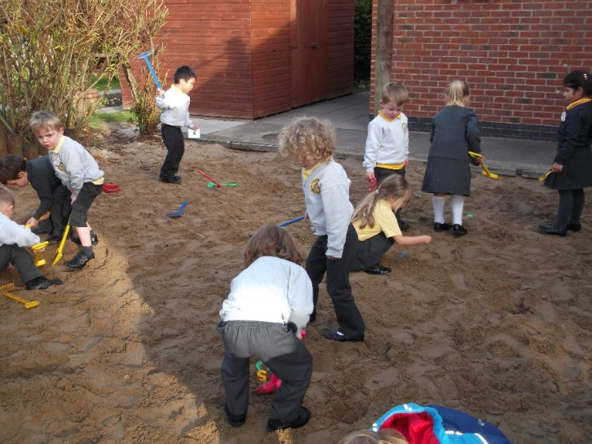
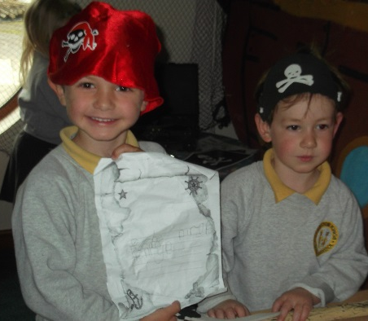
Writing:
Develop gross & fine motor skills and correct pencil grip.
Handwriting – patterns to begin
Phoneme frames
Variety of writing resources/books etc
Writing opportunities are part of children’s play
Mark making/emergent writing books

Slide 14
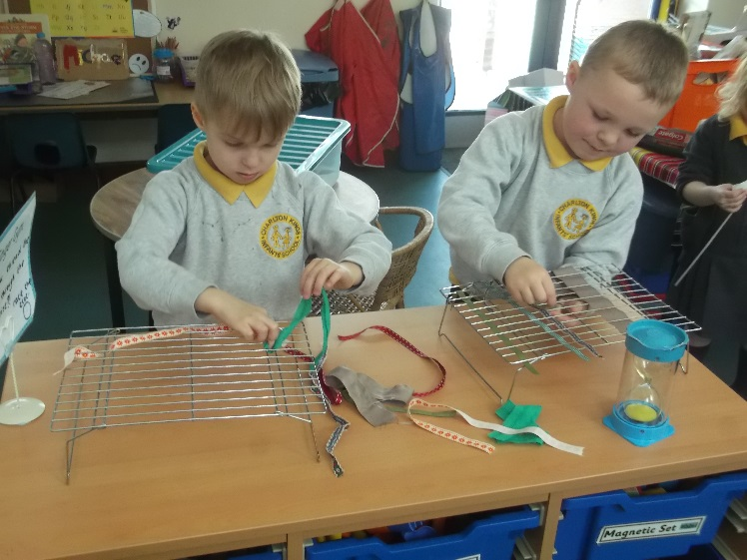
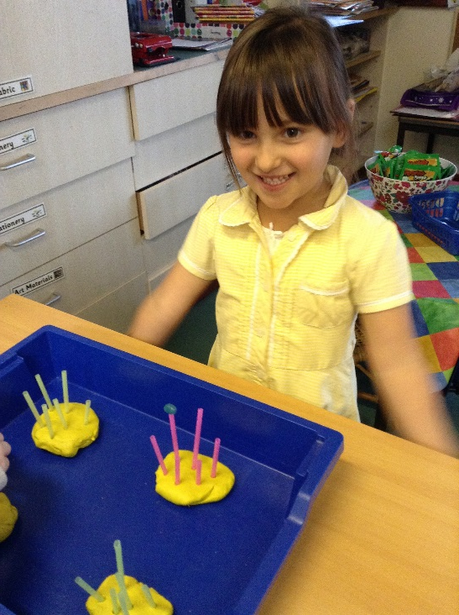
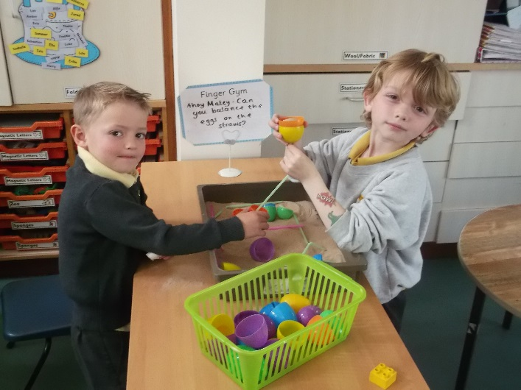
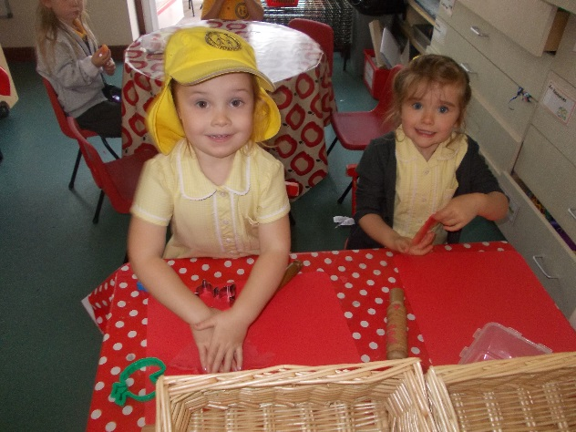
Gross & Fine motor control:

Slide 15
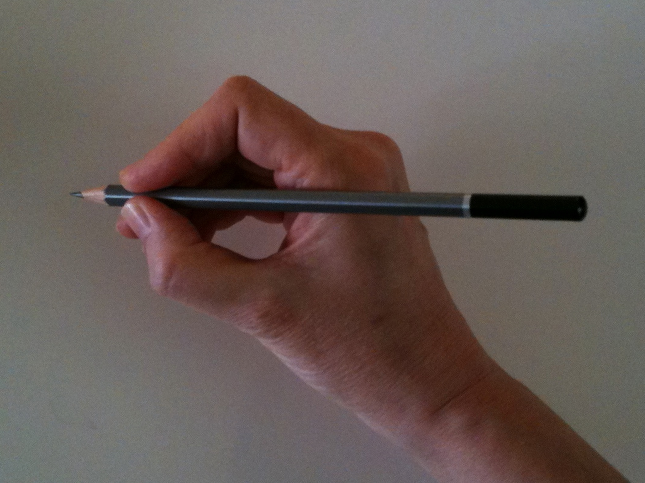
HANDWRITING
Write all the upper case (capital) and lower case letter shapes of the alphabet with the correct tripod pencil hold.
“Let me help you...”
Notes:
There are many different pencil grips that we see…
We can model the correct pencil hold in a very kind way. “Let me help you”.

Slide 16
“Let me show you again...”
“Froggy legs with the log under”
Notes:
Child-friendly phrase, ‘Froggy legs with the log under’ or ‘sitting on a log’. Demonstrate by forming the back legs of the frog (thumb and index finger), pinch the pencil at the end of the cylinder shape (not down the cone) and place the middle finger under the pencil. This creates the tripod grip.
We can model the correct pencil hold in a very kind way. “Let me help you, I’ll show you again how to do it!.

Slide 17
How can I help at home?:
Read daily with your child at home and record in the diary
Track the rhyme of the week and practise reciting it
Play rhyming/alliteration games
Encourage children to speak in full sentences
Encourage large drawing/writing activities which strengthen gross motor skills
Talk about the sound learnt each day – look for objects for our sound table
Complete activities on reverse of the phonics sheets in the reading and phonics folder

Slide 18
What books will I get?
Rhyme of the week book
Reading and phonics folder
Phonically decodable books. One will match the sounds that we are teaching and one will match the phonemes that your child knows.
Home sharing books from our library
Notes:
Share the books with the parents and model how to read with a child.
Emphasise how important it is to repeat texts

Slide 19
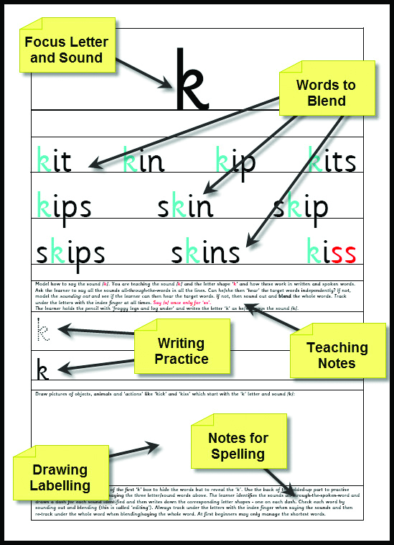
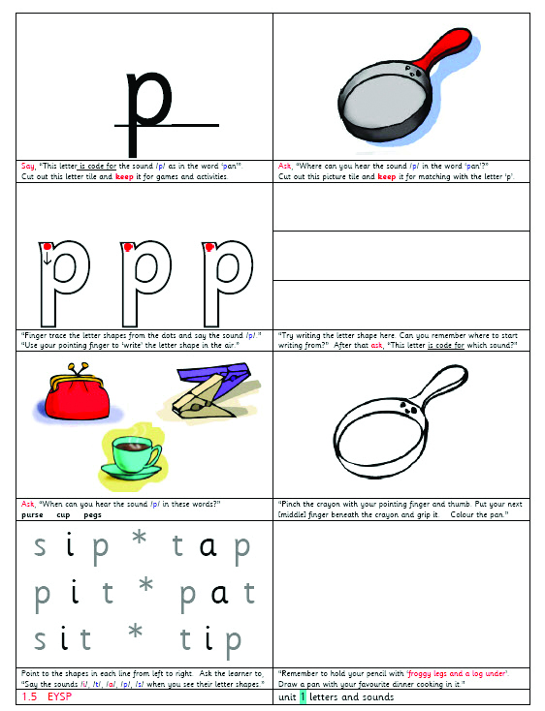
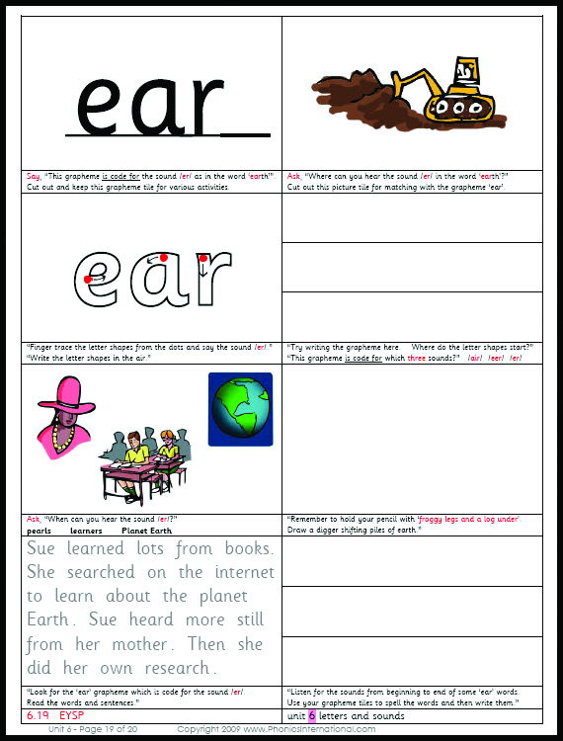
ESSENTIAL MULTI-SKILLS ACTIVITY SHEETS
Individual practice of the
sub-skills and core skills
for reading, spelling
and handwriting
Notes:
‘core’ and effective these skills’ activities are. Model the finger-tracing for the letter shape whilst saying the sound. Model the finger tracking under the graphemes for sounding out and blending. Model the tallying sounds to thumb and fingers of the left hand, palm facing, for the spelling routine. Count the sounds, write sound dashes on the back of the folded-up part of the Activity Sheet, and say the sounds whilst handwriting the graphemes from left to right. Finish by finger tracking under the graphemes from left to right whilst saying the sounds and blending the word. Is it correct? If so, tick the word.]

Slide 20
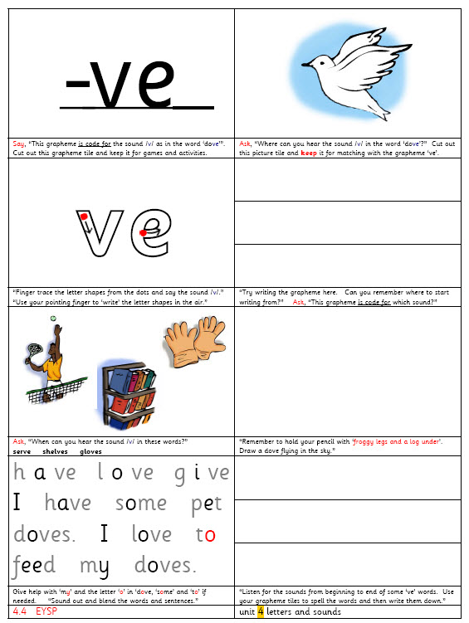
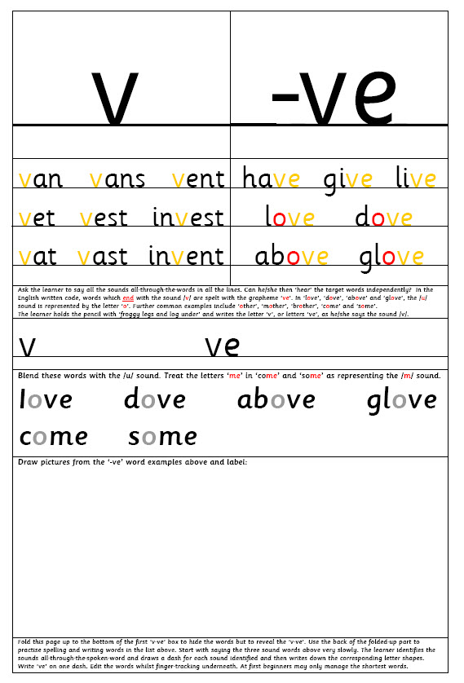
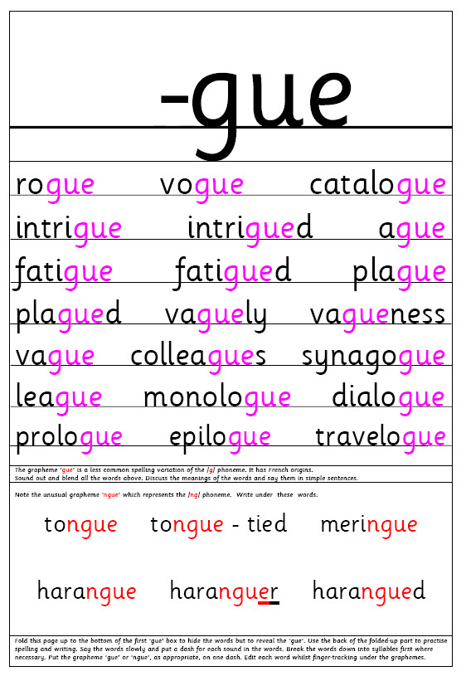
Examples of sheets in the reading and phonics folder
Notes:
Core VAK Activity Sheet – VERY fit for purpose. These develop cumulatively throughout the whole programme. Once children can read, they are continued to support spelling.
The alphabetic code knowledge is included on the Activity Sheets for the supporting adult and to inform the parents.

Slide 21

How the adult supports the learner to read is very important...
Tell the learner the code:
play In this word, these letters
are code for /ai/.
Notes:
Children will need different levels of support when reading aloud.
There are different ways that the adult can help the learner to read the words.

Slide 22
2. Alternatively, model the sounding out and blending of the word to the learner.
3. Or simply tell the learner the words which are proving too difficult.

Slide 23
‘CEW Words’
Such words are introduced steadily throughout each year group.
It is better to tell the learner a really challenging word, than to tell the learner to ‘guess’ the word.
Notes:
Encourage your child to blend and allow time for this.
If you are not feeling confident about supporting the reading in a code-based way, then tell your child the tricky words when he or she is ‘stuck’.
[You may wish to mention and/or show any cumulative, decodable reading books which you use in schools for home-reading or reading in school.]

Slide 24
And always the adult should discuss the content of the book with the child!

Slide 25
Glossary
Phoneme - A phoneme is the smallest unit of sound in speech. When we teach reading we teach children which letters represent those sounds. For example – the word ‘hat’ has 3 phonemes – ‘h’ ‘a’ and ‘t’.
Grapheme - A grapheme is a letter or a number of letters that represent the sounds in our speech. So a grapheme will be the letter/letters that represent a phoneme.
Digraph - A digraph is a 2 letter grapheme e.g. ‘ch’ in ‘chip’.
Trigraph - A trigraph is a 3 letter grapheme e.g. ‘igh’ in ‘high.
CVC – consonant-vowel-consonant.

Slide 26
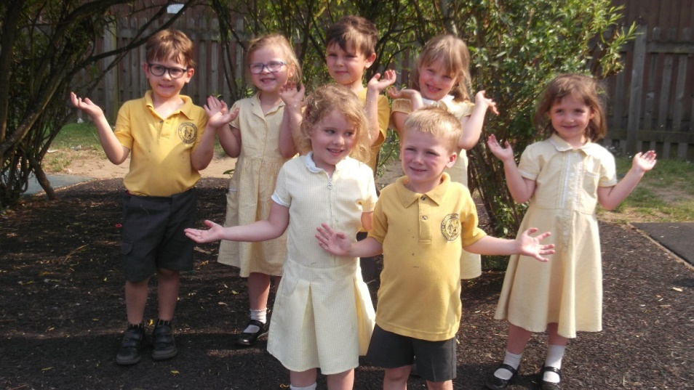
Any questions?

