Slide 1
Mastery Maths
at CKIS

Slide 2
What is “Mastery Maths?”
Mastery is not just being able to use bigger numbers, work faster, memorise key facts and procedures and to answer test questions correctly. Mastery involves knowing why and how. It means being able to use your knowledge appropriately, flexibly and creatively and to apply it in new and unfamiliar situations.
For all maths concepts teachers need to ensure that children are “challenged through being offered rich and sophisticated problems.” After developing fluency, children need to show that they can apply their knowledge in mathematics and then move on even further to prove they have mastered the concept.
Notes:
Magic maths and mastery maths
RESPECT characters

Slide 3
Our vision
At Charlton Kings Infants’ School we acknowledge the importance of mathematics.
It is a core subject in the National Curriculum and listed as a ‘specific area’ in the EYFS framework. We aim to address the National Curriculum and EYFS requirements by developing each child’s mathematical potential to the full and help each child derive personal pleasure and satisfaction.
We aim to raise the profile of mathematics by demonstrating to children how useful and powerful mathematics is as a means of communication and as a tool to solve every day problems. We aim to promote an interest in the subject and to develop understanding of it, as a tool to make sense of the world. We encourage the interest and involvement of parents in the mathematical education of their children.
Notes:
Fun, engaging, practical, exciting, solving problems…children really do love maths here at CKIS! Lots of spotting mistakes…Colin the Caribou as well as the teachers…. What have I done wrong? What have I forgotten? Challenge me and each other? Prove it…. How do you know that?

Slide 4
Core belief
Our beliefs at CKIS:
We believe that ability within mathematics is not fixed. We are developing the mindsets of children and adults alike to promote a positive growth mind-set and an ‘I will do this’ attitude to mathematics.
We believe that through quality first teaching, children learning together and immediate intervention, all children have the potential to ‘go deeper’ and broaden their understanding of mathematical concepts.
Notes:
Scoop groups
Its busy….one group using concrete resources with CT, another group solving the deepen it problem…applying their new knowledge….acting in that moment….responding to the children… all engaged, active, challenging themselves and others.

Slide 5
Innate ability
Effort-based ability
Intelligence can grow
Intelligence is fixed
Effort leads to success
Ability leads to success
When the going gets tough ... I get smarter
When the going gets tough ... I get found out
I only need to believe in myself
I need to be viewed as able
Success is doing better than others
Success is the making of targets
When the going gets tough ... dig in and persist
When the going gets tough ... give up, it’s hopeless
Notes:
Some people think intelligence can’t change - Mathematics Mastery believe in Growth mindset as researched by Professor Carol Dweck
Individuals can be placed on a continuum according to their implicit views of where ability comes from.
Fixed-mindset individuals dread failure because it is a negative statement on their basic abilities, while growth mindset individuals don't mind failure as much because they realize their performance can be improved. These two mindsets play an important role in all aspects of a person's life. Dweck argues that the growth mindset will allow a person to live a less stressful and more successful life.
This is important because (1) individuals with a "growth" theory are more likely to continue working hard despite setbacks and (2) individuals' theories of intelligence can be affected by subtle environmental cues. For example, children given praise such as "good job, you're very smart" are much more likely to develop a fixed mindset, whereas if given compliments like "good job, you worked very hard" they are likely to develop a growth mindset. In other words, it is possible to encourage students, for example, to persist despite failure by encouraging them to think about learning in a certain way.

Slide 6
Key principles
Fewer topics in greater depth
Mastery for all pupils
Number sense and place value come first
Problem solving is central
Notes:
Opportunities are provided throughout Mathematics Mastery for pupils to use reasoning skills to make connections between prior knowledge and newly presented material. These connections will help foster a deeper understanding of the maths concepts.
Differentiation through depth, cumulative learning, AfL
Traditional algorithms meaningfully taught.
Comprehension, calculation and problem solving developed simultaneously.

Slide 7
What does the National Curriculum say?
“Pupils who grasp concepts rapidly should be challenged through being offered rich and sophisticated problems before any acceleration through new content.”
“Those who are not sufficiently fluent should consolidate their understanding, including through additional practice, before moving on.”
Notes:
Explain that this means there is one curriculum for all, with all children working on the same concepts at the same time.
Children who grasp concepts more quickly are not accelerated beyond the objectives for their year group as they may have been in the past. Children who are struggling and at risk of falling behind

Slide 8
Lesson structure – Mastering Number
Mastery lessons follow a 4-part structure. This keeps the lesson pacy, gives flow and allows more opportunities to teach creatively, give feedback and assess learning.
Pupils have access to plenty of concrete materials such as bead strings and place value counters so that they have time to fully explore mathematics.
Notes:
Hook - picture/video/song, learning outcome, what do we already know that will help us today, key vocab, key teaching, stem sentences, do it, secure it and deepen it, review

Slide 9
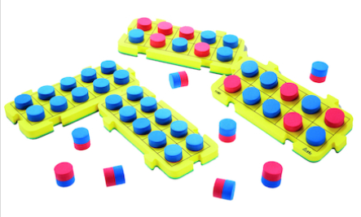
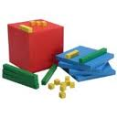
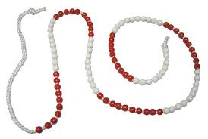

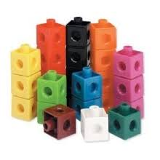
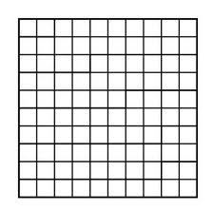
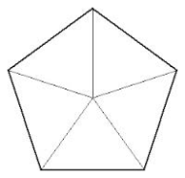
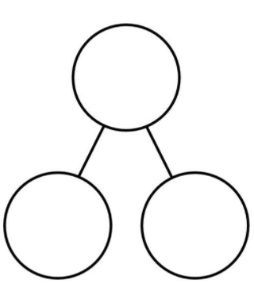
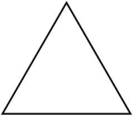

What are concrete/pictorial resources?
Tens frames
Base Ten
Shapes
Multilink cubes
100 grids
Part, part whole model
Number lines
Notes:
These are some examples of materials that can be used at the “concrete” and “pictorial” stages to support students at all levels of attainment to access mathematics and deepen their understanding.

Slide 10
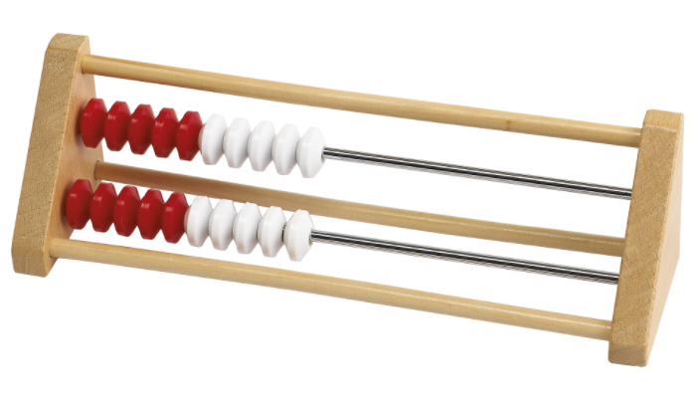
New resources coming….
The Rekenrek
Notes:
New resource for this year….new nationwide program Mastering Number program. NCETM Our magic maths session which is in addition to our mastery sessions – to build fluency
Secure firm foundation in the development of number sense from yr to y2
Confidence and flexibility with number
We are awaiting our delivery of the rekenreks so watch this space – lots of subitising seeing without counting– In YR start with 2 in dot arranged on the screen how many? Can you show me 2 on your fingers. Any other way? What can you see that’s not 2? What is it? What is it not? 2 or not 2….
Y2 = Show 4 beads on your display rekenrek (or an interactive rekenrek). 1 push 4.
How many beads can you see? How many does 4 need to ‘make 5’?
Use the stem sentence: _____ needs _____ to make 5.

Slide 11
Your turn!
Using the resources available, can you show the number 15?
Notes:
Have bags of mixed resources and get parents to show different ways of making number 15….

Slide 12
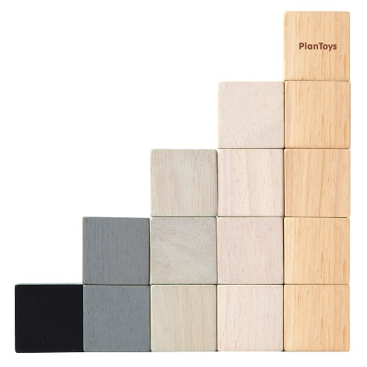


15
Notes:
Explain that all these are ways of representing the number. Children need to understand the six-ness of 6 rather than just be able to count to 6 and recognise the number.
Pupils are not going to be working through the curriculum more quickly, but going deeper into it. In Year 1 it is imperative that pupils have full understanding of number sense, number bonds and place value, as all number work in maths builds on what is taught in this year group.

Slide 13
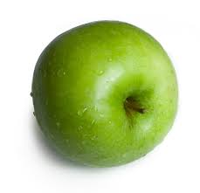
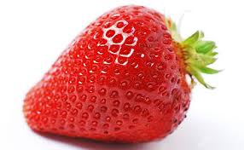
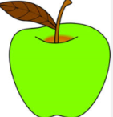
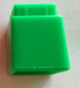
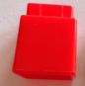



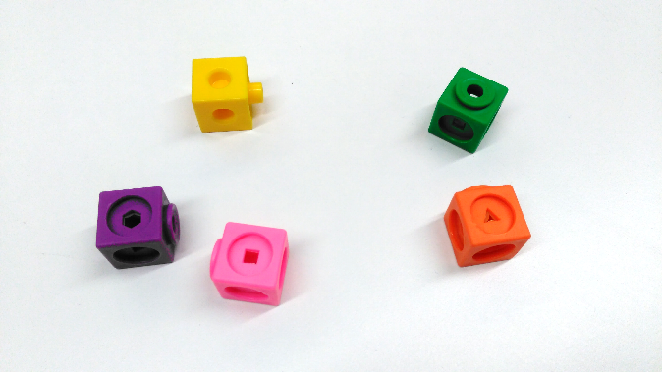
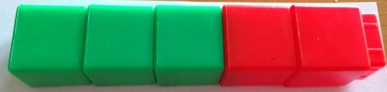
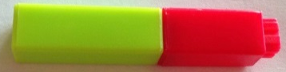
Ben has 3 apples and Joe has 2 strawberries. How many pieces of fruit do they have altogether?
3
2
?
Notes:
Time: 2 minutes
Purpose: Demonstrate different representations that may be used to represent word problems
Facilitation: Use of actual apples and strawberries would be appropriate for pupils still developing their early understanding of number and (animation 1) using generic representations of these (i.e. cubes or counters) needs scaffolding carefully, never assuming that pupils will automatically make the connection between these different representations. What do the 3 green cubes represent? What about the 2 red ones?
(2) Initial pictorial representations should closely resemble the originals to support pupils making connections between them but once pupils are well-practised at representing items more abstractly, it is more efficient to use generic representations – (3) both concretely and pictorially.
(4) If we are interested in scaffolding pupils’ understanding of and use of bar models, this concrete and this pictorial representation are useful. The different colours allow the two parts to be seen in the concrete and using a generic shape like a square is relatively simple to draw and can be used to represent any item.
(5) In this last concrete representation using Cuisenaire rods, the one-to-one correspondence is now no longer visible so it is vital that pupils are secure in the numbers involved before representations like this are used. (6) It can be a useful scaffold for the abstract bar model too.
There is not a specific correct/incorrect progression of representations here, except that pupils need to experience the maths concretely first if they are going to be able to use pictorial representations and use language or abstract representations to express it. Whichever representations are used by teachers and pupils, careful links must be made between new ones and previous ones so that pupils can understand them meaningfully.
Lead into next slide: While each of these representations is useful and important, we can see that bar models are the most efficient way of representing the maths.
Resources: None

Slide 14
Part-whole relationships
?
3
2
?
Notes:
Time: 1 minute
Purpose: Connect bar models to part-whole models
Facilitation: Each of the representations on the previous slide emphasised the fact that there were two parts and that the whole could be found by combining the parts.
When using the early concrete and pictorial representations, an additional support for helping pupils to see this relationship between parts and whole is to use the part-whole model like this – and pupils do so throughout Reception and Year 1 in preparation for using the more abstract bar model from Year 2 onwards. The use of the part-whole model continues through Key Stage Two and the teaching materials within each year group, along with the Progression in Calculations modelling videos will support teachers both in using the part-whole model and how to scaffold pupil understanding from the part-whole model to the bar model – but it may look something like this. (1), (2), (3).
Lead into next slide: So why are the relationships between the values (in a mathematical situation) so important?
Resources: none

Slide 15
Bar models...…
…pictorial/abstract representations of known and unknown values in a mathematical situation and the relationships between them.
…used for ‘making sense of’ the maths within a problem or mathematical situation.
Notes:
Bar models are one way of representing a mathematical situation and are particularly helpful to make sense of what is going on in a word problem but, equally, to solve problems in real life, supporting the problem solver in identifying the maths that needs doing.
Lead into next slide: There are some additional uses of bar models
Resources: None

Slide 16
Misconceptions about bar models
Bar modelling is not:
A method of calculation
A solution
I know my whole is ten and one of my parts is four. How can I find the other part?
?
4
10
Notes:
identify what calculation they need to perform.
(1) Pupils should be able to use the bar model to identify that the calculation 10 subtract 4 will give them the missing part.
(2) In the same way that the bar model doesn’t give you the result, it is not a result in itself. As it is one way of representing the problem it cannot be an answer to the problem. Pupils can make the mistake of thinking that they have completed a problem when they have drawn a bar model to represent it.
Lead into next slide: We’ve got some idea of what bar models are for and the majority of the workshop will focus on how to use them and how to teach pupils to use them. Now we’re going to look at the reasons why we might want to use them in the first place.
Resources: None

Slide 17
Mathematical language
Our lessons provide opportunities for pupils to communicate and develop mathematical language through:
Sharing essential vocabulary at the beginning of every lesson and insisting on its use throughout
Modelling clear sentence structures using mathematical language
Paired language development activities
Review periods which give a further opportunity to assess understanding through pupil explanations.
Notes:
You might find that children quickly become very articulate and start using words and phrases you have not heard before.
commutativity
partitioning
addend + addend = sum
Factor x factor = product

Slide 18
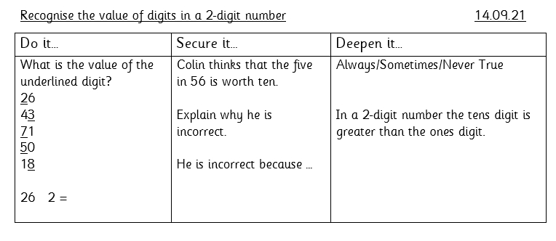
Example of our lesson sheet
Notes:
Secure it
He is incorrect because…. The five in 56 is 5 tens not one ten/56 has five tens and not 1 ten. 56 = 50 + 6
I say 56 I mean 5 tens and 6 ones.
Deepen it
It is sometime true because in 81 the tens digit is greater and in 29 the one digit is greater.

Slide 19
How will children’s work be recorded?
Task sheets
Books
Photographs
Teacher comments
Notes:
May not be reems of maths….hands on, practical resources, discussions,

Slide 20
What can you do at home?
Ask children to help you with tasks e.g. measuring, cooking etc.
Solve problems together – how many people are coming to dinner?
Practice times tables (Y2) – singing, chanting.
Play Mathletics/Numbots online.
Talk about Maths – ask them what they have done at school, vocabulary etc. Let them teach you!
Ask them to explain new vocabulary –
Commutativity
partition
addend + addend = sum
Factor x factor = product

